Slide 1

Tree-Extending Hints
Joe Price
joe_price@byu.edu
rll.byu.edu
facebook.com/BYUrecordlinkinglab

Slide 2
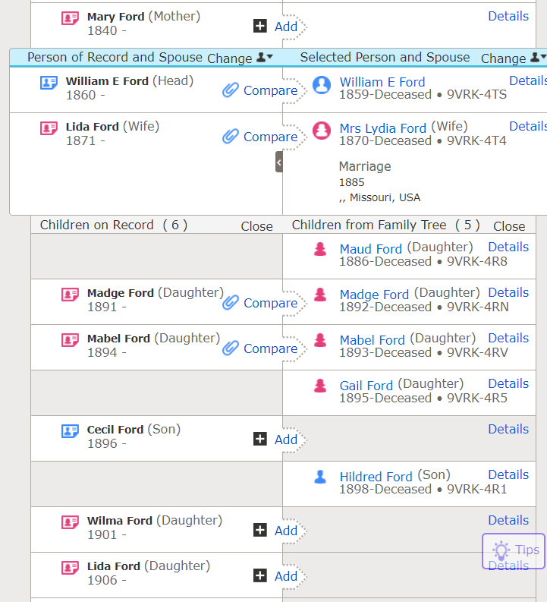

Slide 3
Power of tree-extending hints
Tree-extending hint: a record hint where part of the family is on the Family Tree and part is not.
In this example, we would be able to add Mary, Cecil, Wilma, and Lida to the tree.

Slide 4
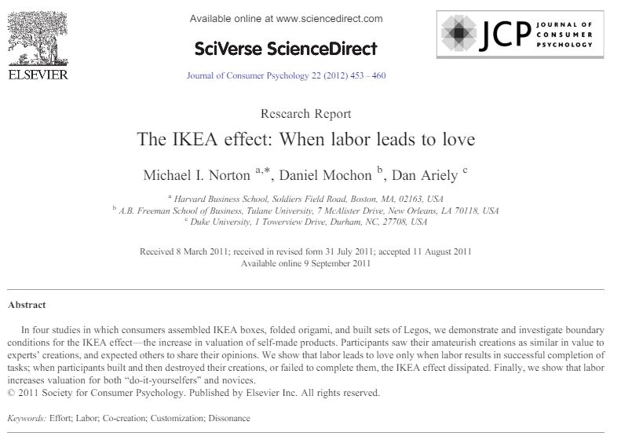
IKEA effect
Tree-extending hints provide the ideal mix of labor and success.
The user is adding new people to the tree.

Slide 5
Three ways to access these hints
FamilySearch email campaign
  familysearch.org/campaign/hints
RLL volunteer portal
  bit.ly/rll_volunteer
RLL customized hints app
  bit.ly/rll_custom

Slide 6
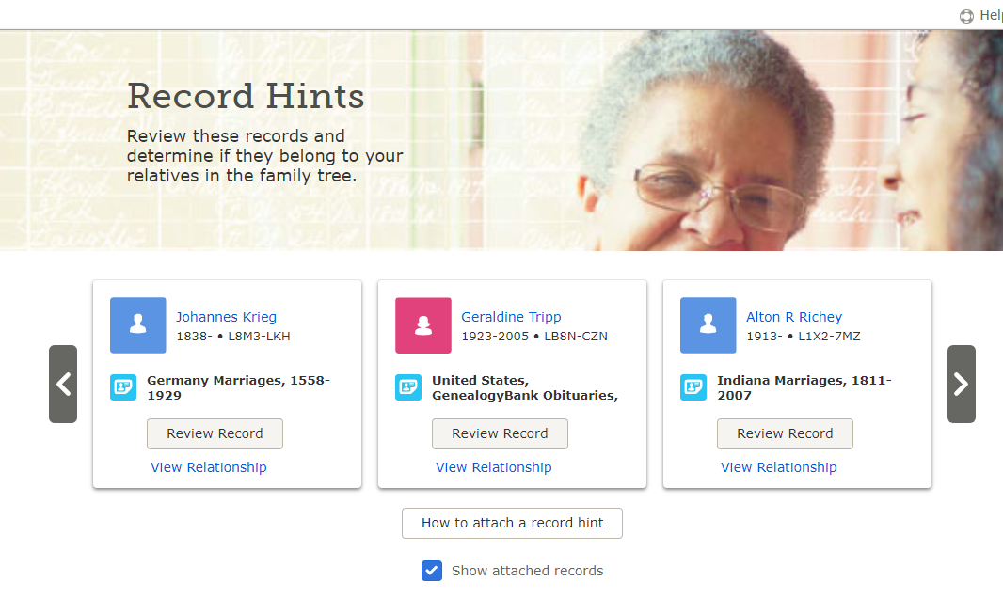
#1 FamilySearch Hints campaign
familysearch.org/campaign/hints

Slide 7
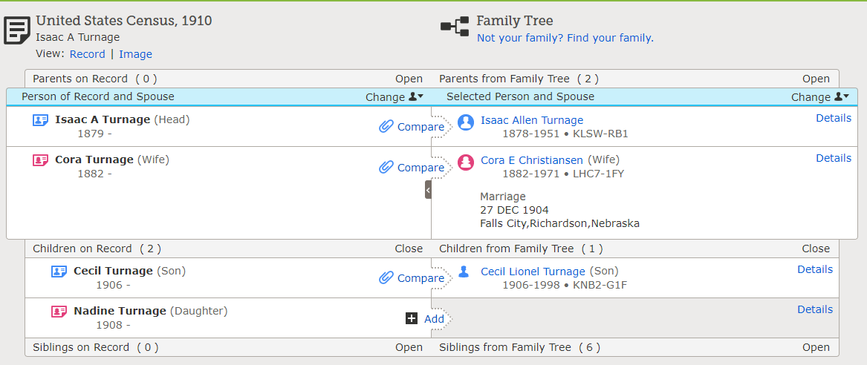

Slide 8
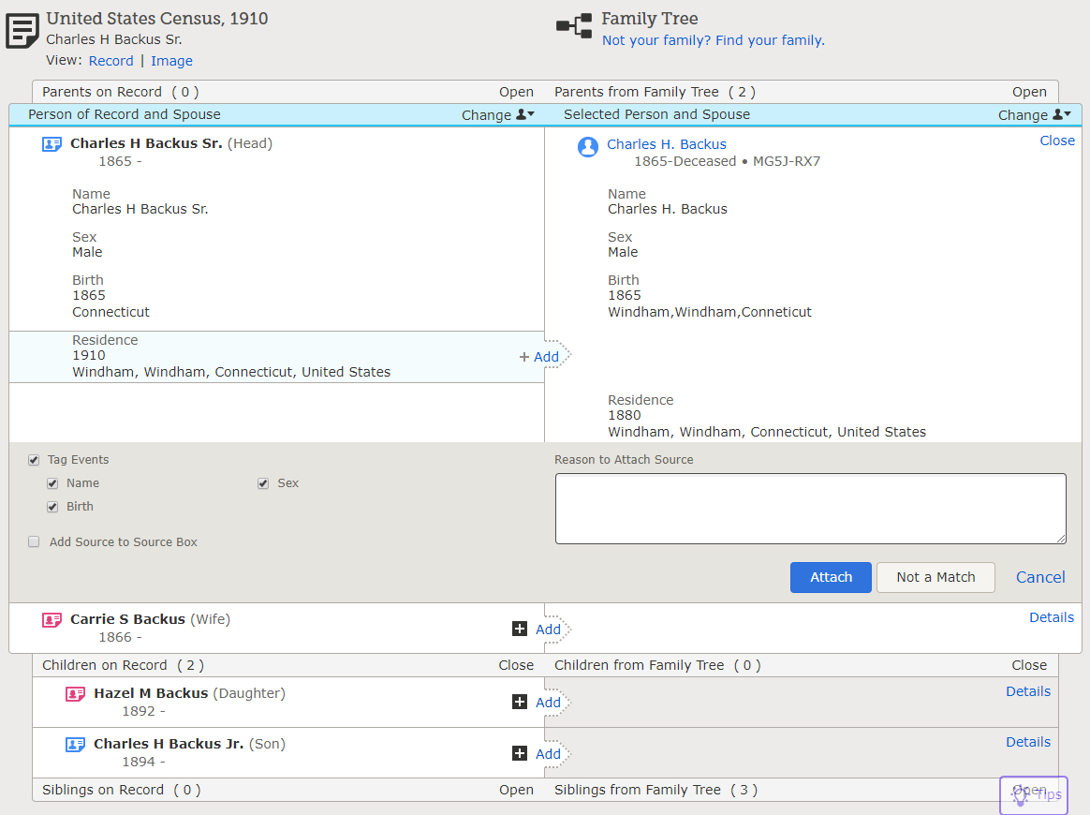

Slide 9
Consultant planner
You can see these hints for people that you have added to your consultant planner.
This will allow you to check ahead for them and clear away the ones that are hard.
Help new users focus on the 1900 and 1910 US Censuses.
  Very easy to work with.
  People are in family units.
  Lots of children are missing from families that you can add in.
For more advanced users, the Canadian + European records (particularly Sweden) can be really great.

Slide 10
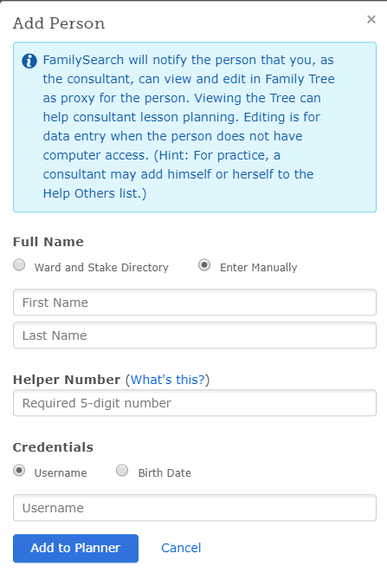
Consultant planner
familysearch.org/ask/planner
The add person function is the easiest to use if you are already next to the person.
Really easy to do on a phone. Just use a browser instead of the app.

Slide 11
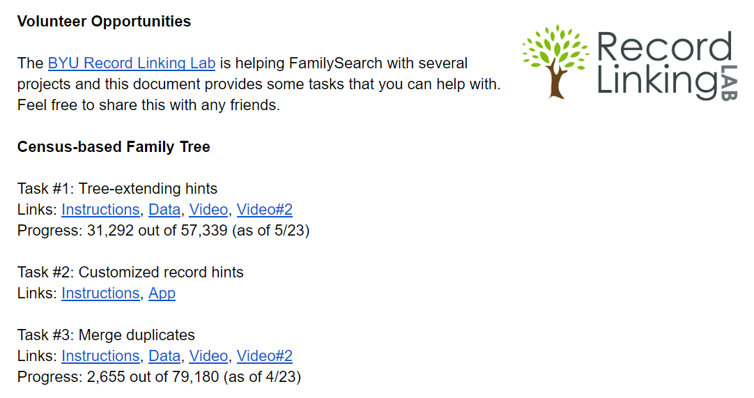
#2 RLL volunteer portal
bit.ly/rll_volunteer

Slide 12
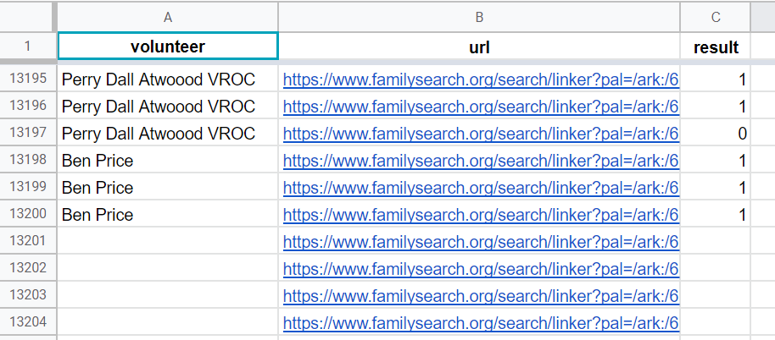
Volunteer portal
To check out rows, put your name in the volunteer column.
Click on the url to go to the source linker screen and then record the result in the result column (1, 0.5, 0).

Slide 13
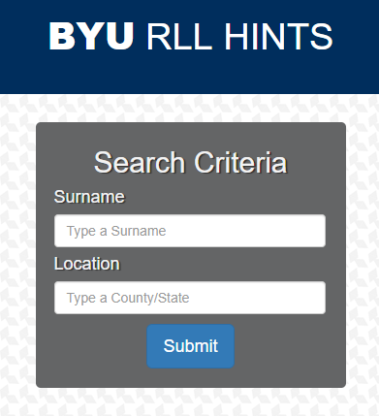
#3 Customized hints
bit.ly/rll_custom
Allows you to search for US census hints by surname or place.

Slide 14
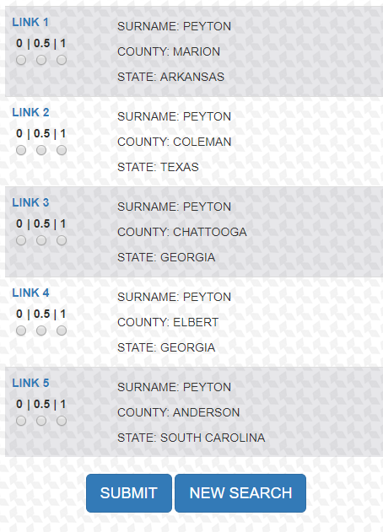
Customized hints
If you click the blue button “link”, it will take you right into source linker and you can decide whether the record matches the person on the Family.
If so, click “1”. If not sure, “0.5”. If sure it is not a match, “0”.
When done, click “submit”.

Slide 15


Mobile devices
These three approaches can all be done on your mobile device.
It takes a bit to adjust to the smaller screen and need to move between apps and windows within your browser.
You’ll be able to do this work in little chunks when you have free moments throughout the day.
Our lab will post some separate instructions on how to do these things on your phone but try it out yourself.

Slide 16
Why do this?

Slide 17
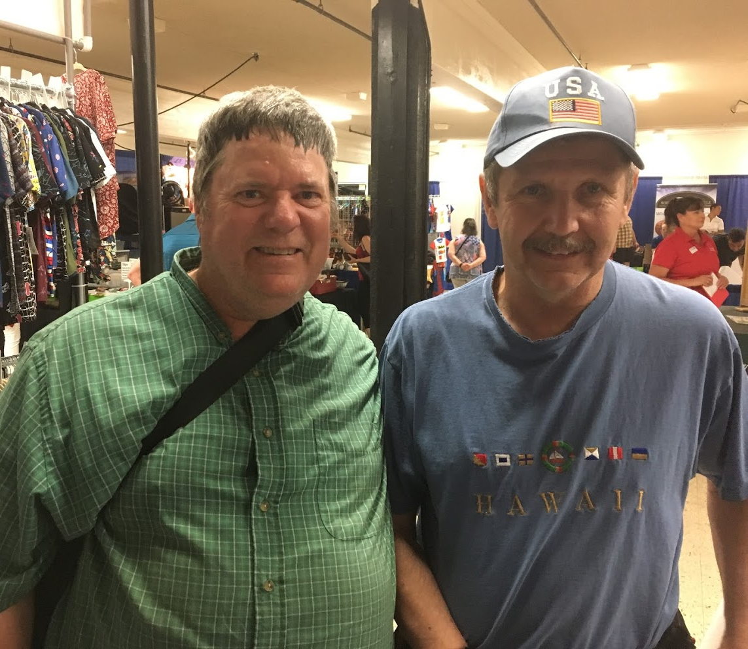
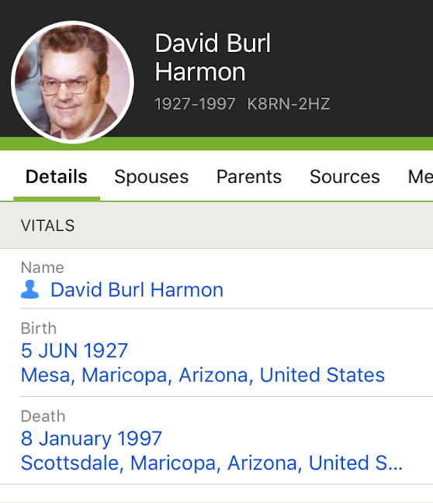
Involve more people in family history
About 50% of the time, the parent or grandparent of the individual was on the Family Tree. We could provide more discovery experiences if we could get that closer to 90%.

Slide 18
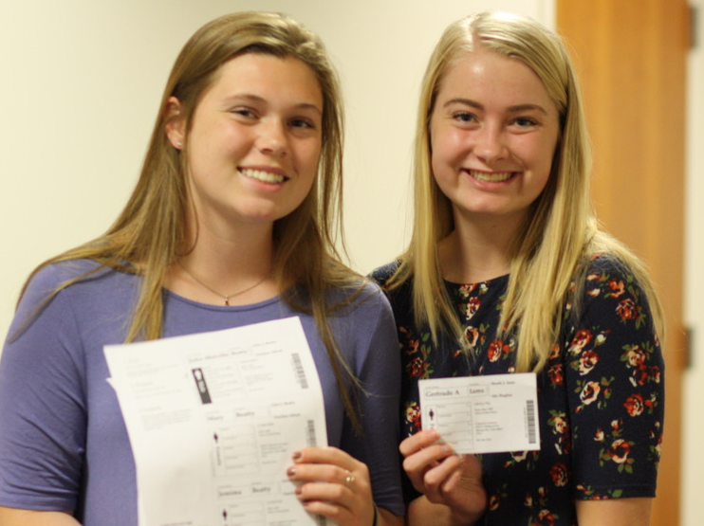
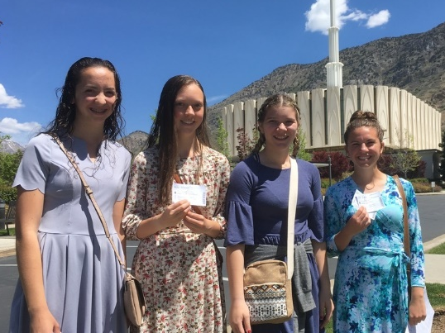
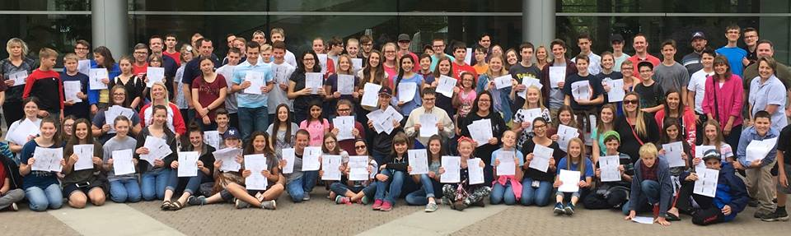
Help youth find new family names

Slide 19
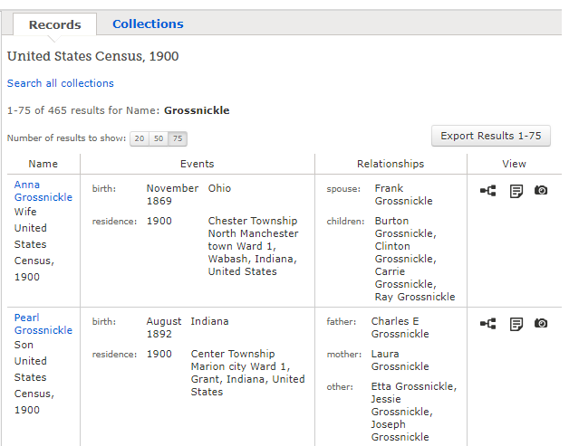
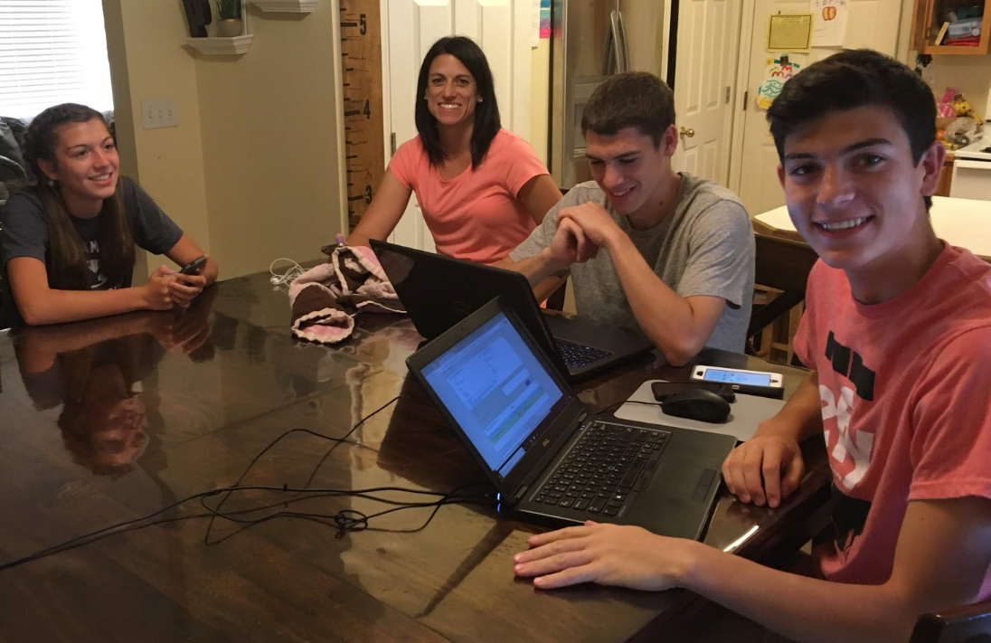
Family name networks
We can show the Census Tree for specific last names and help families expand the coverage of their family name on the Family Tree and connect the different families together.

Slide 20
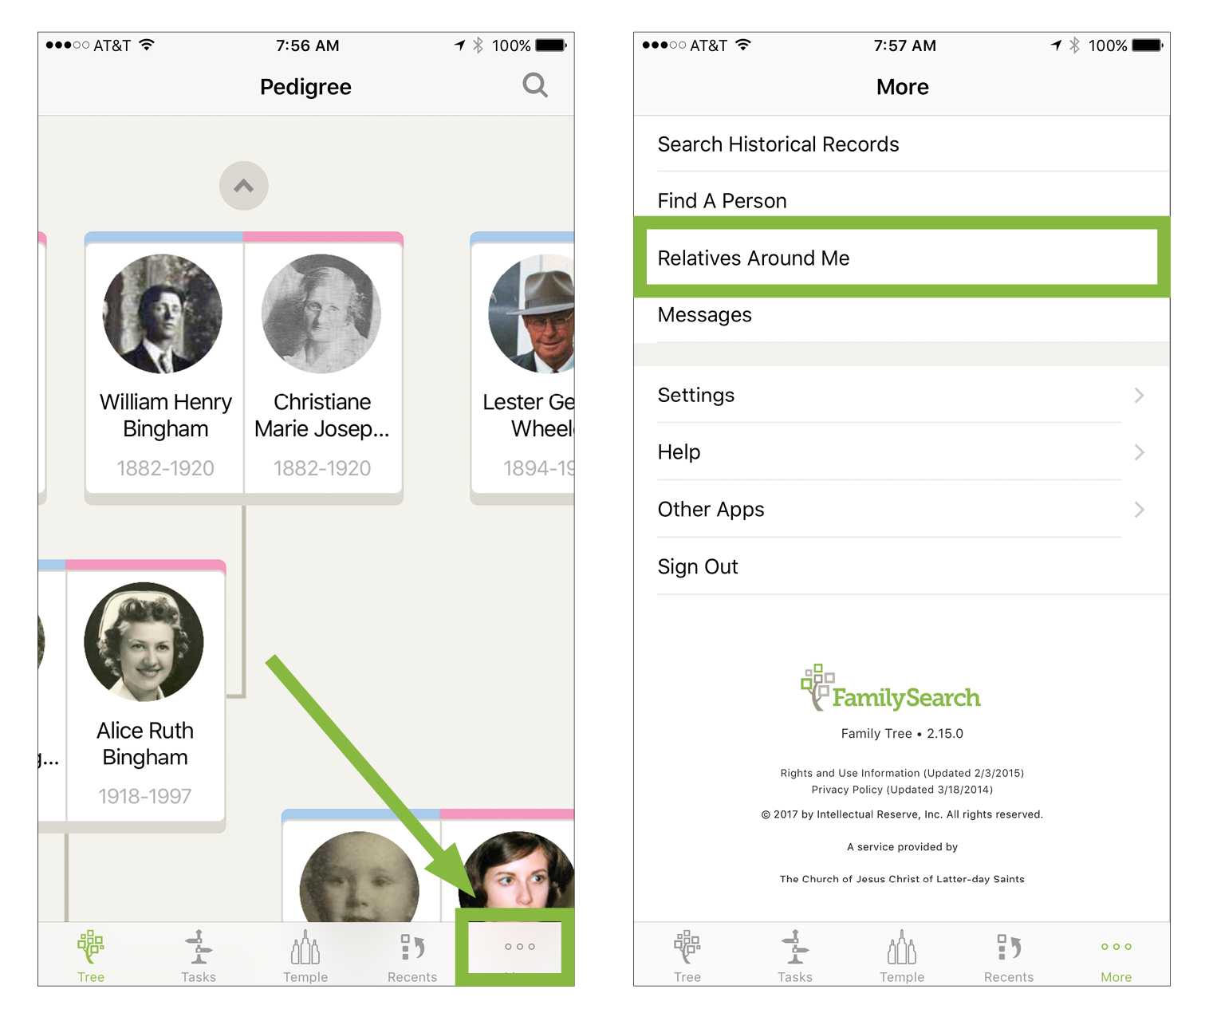
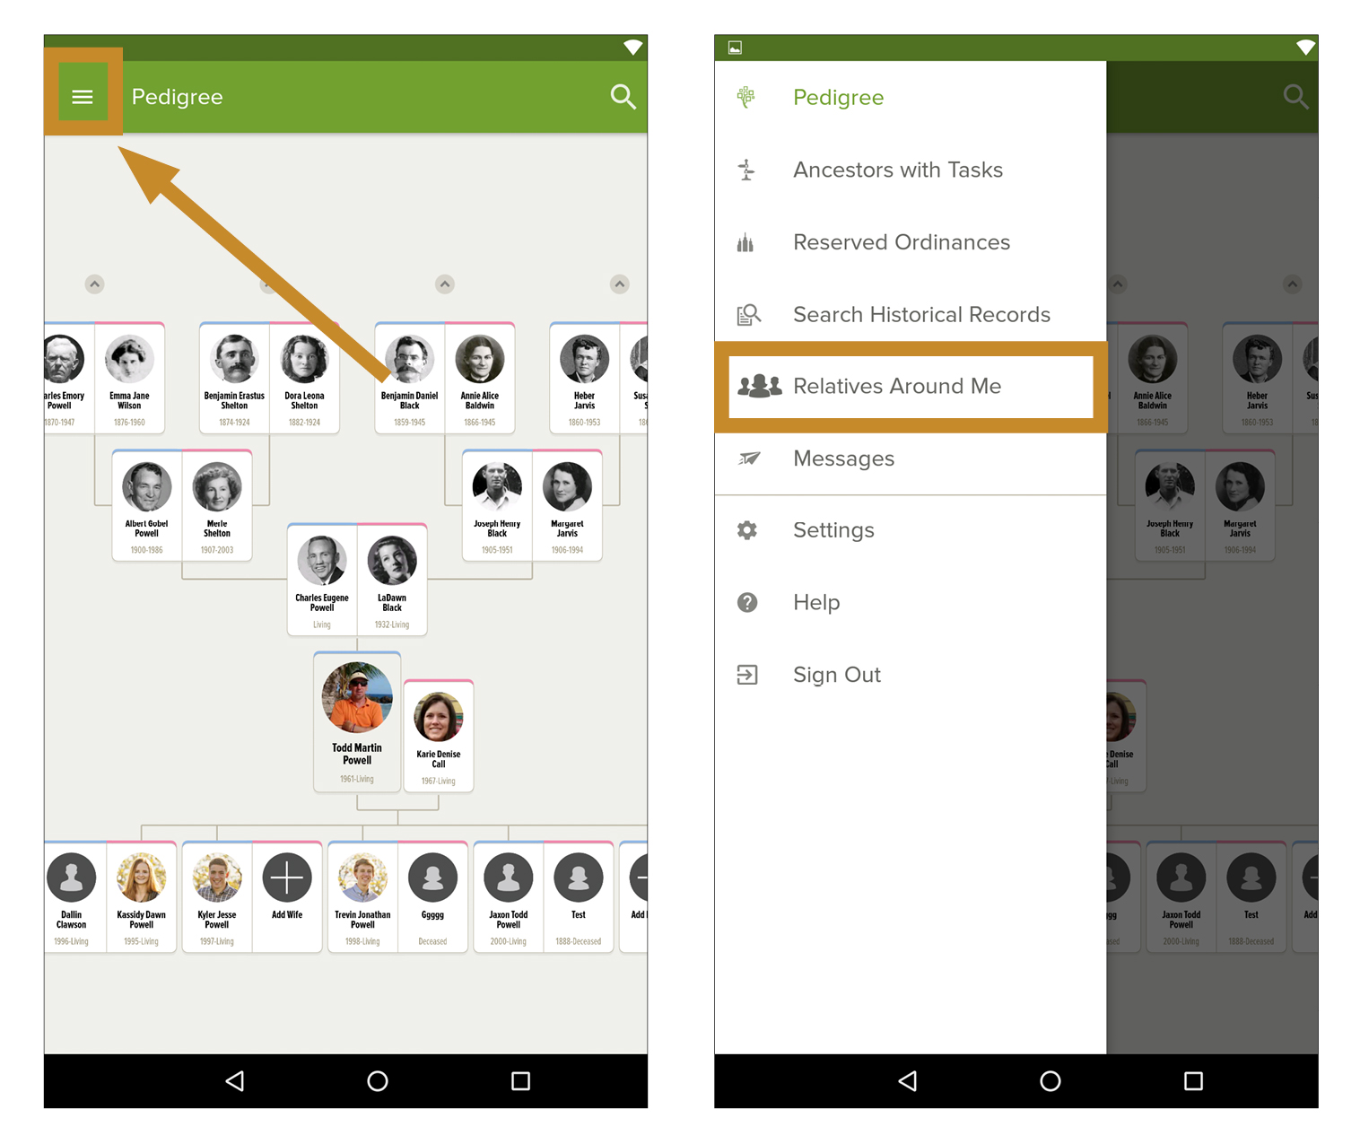
Relatives around me
How to use Relatives Around Me for iOS.
How to use Relatives Around Me for Android.

Slide 21
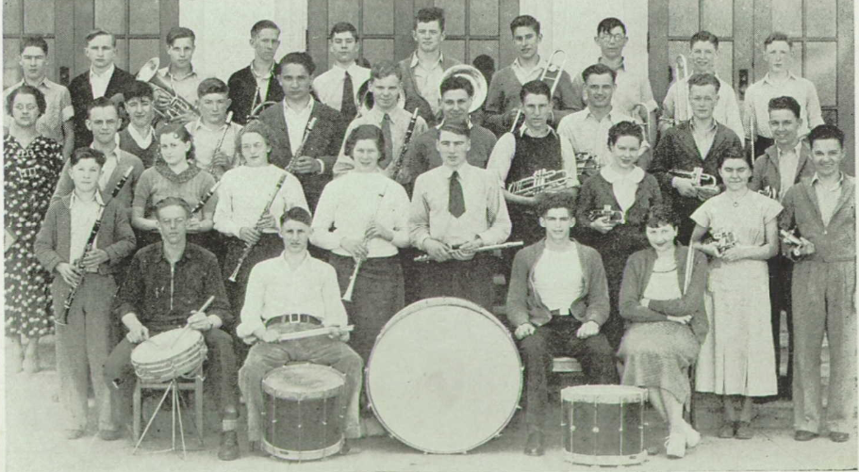
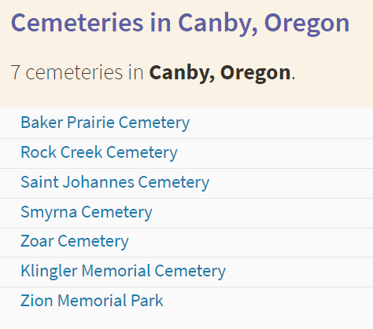
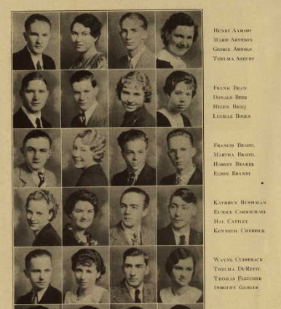
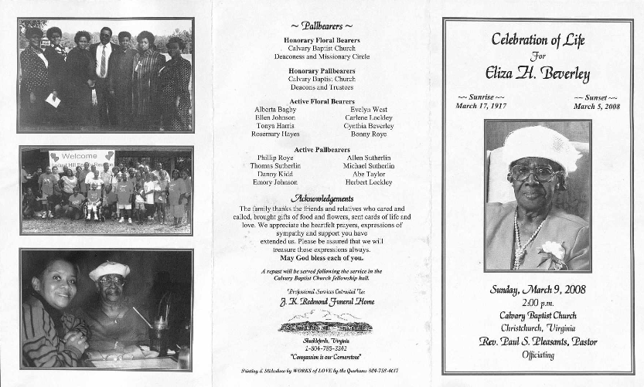
Community reconstitution
Yearbooks
Photo collections
Libraries
Newspapers
Funeral homes
School records
Oral histories
Having everyone on the Family Tree creates a place where all of these other record collections can fit in.

Slide 22
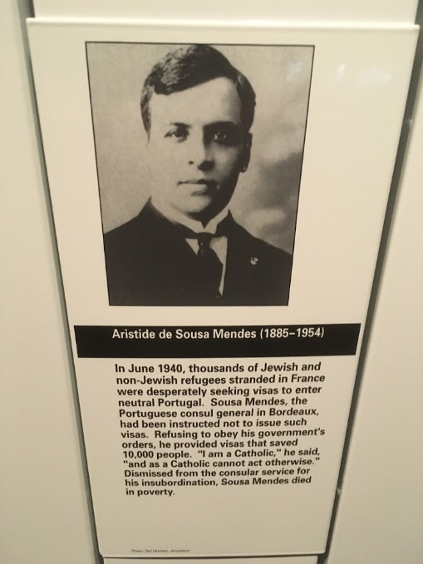
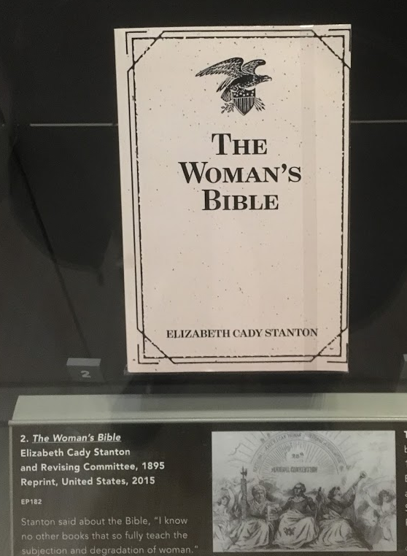
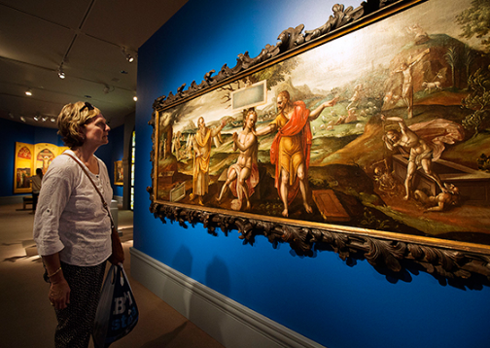
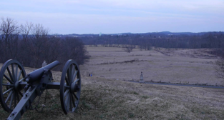
Museums and historical sites
Where do I belong?
How does this connect with me?

Slide 23
How close are we?
There were 217 million people who appear in at least one Census between 1850 and 1940.
  Of these, 132 million were born before 1910.
We decided to focus on when people are between the age of 0 and 10 (excludes many immigrants).
We took a random sample of 100 children from the 1900 census and then tried to find them on the Family Tree.
If they weren’t on the tree already, we added them and began to connect them to family members until we bumped into someone on the Family Tree.
We attached sources and merged any duplicates in the process.

Slide 24
How close are we?
We found that 63% of these children were already on the Family Tree.
Another 19% were closely related to some one on the tree.
This means that using the current tree-extending hints we could get to 82% coverage pretty quickly.
On average, a person has about 13 one-hop relatives and 73 two-hop relatives.
If we use 50% as a conservative estimate of the coverage of the Family Tree, then we still need to add 66 million people (to get everyone born before 1910).

Slide 25
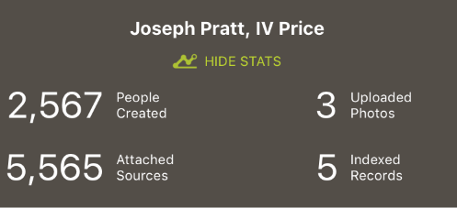
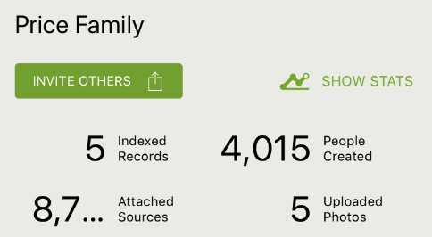
Increased impact
Tree-extending hints increase the impact of the time that we spend doing family history. They allow us to focus on the records that add new people to the Family Tree.
Our family is part of an experiment that allows us to track our stats as a group. We have been participating for almost three weeks.

Slide 26
How close are we?
If you had 1,000 family teams who added 5,000 people to the tree (maybe each would pick a surname or place).
  60 million in the next year
If you had 10,000 people who were well trained at tree-extending hints and added 500 people to the tree each month.
  Also, 60 million in the next year
If you made the hints available to more users (through the campaign, tasks, consultant planner, etc.) then you could have 1,000,000 people add 5 people to the tree each month.
  Also, 60 million in the next year

Slide 27
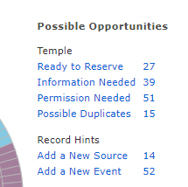
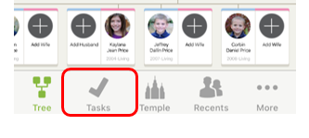
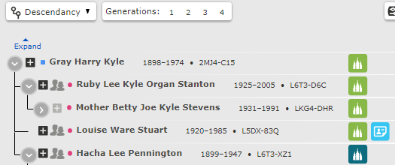
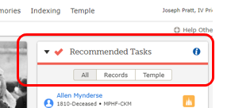
Ways to involve more people
Email campaign
  familysearch.org/campaign/hints
Consultant planner
  familysearch.org/ask/planner
Task button on the phone
Recommended tasks on homepage
Record hints list in consultant planner
Dedicated color on descendancy view

Slide 28
Final notes
Tree-extending hints provide a powerful way to grow the Family Tree.
This approach helps users become familiar with attaching sources and different record types.
This presentation has been focused on the US but could be applied to any country that has record collections that include multiple people.
Expanding the coverage of the Family Tree will facilitate new discovery experiences.
With a concerted effort, it would be possible to have the entire US population on the Family Tree within a year.

Slide 29
Tree-Extending Hints
Joe Price
joe_price@byu.edu
rll.byu.edu
facebook.com/BYUrecordlinkinglab

