Slide 1
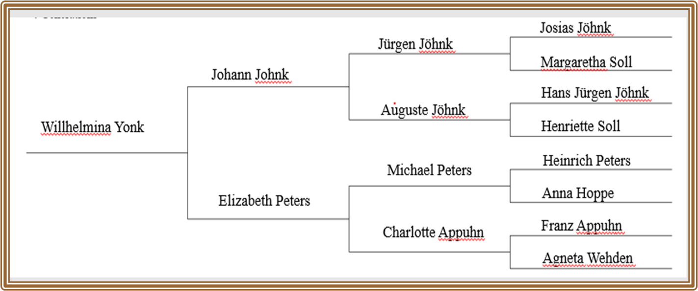
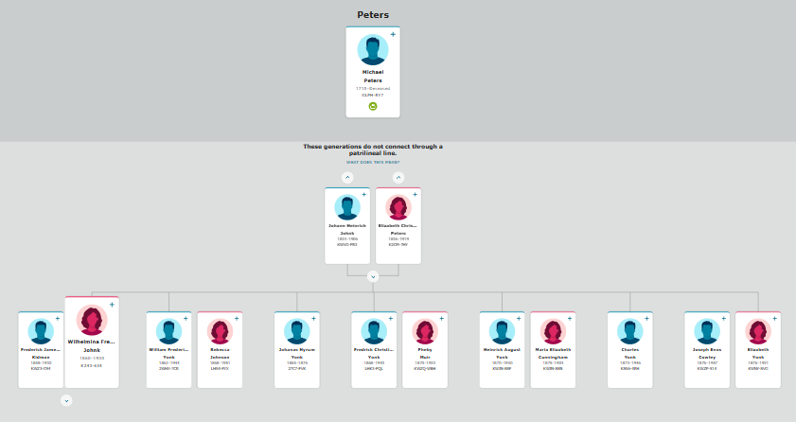
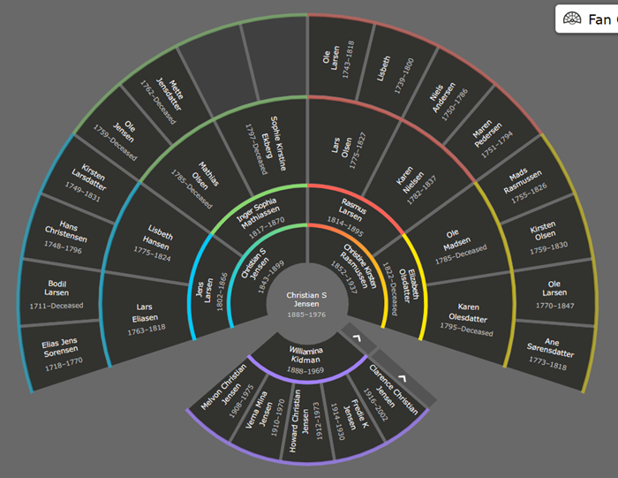
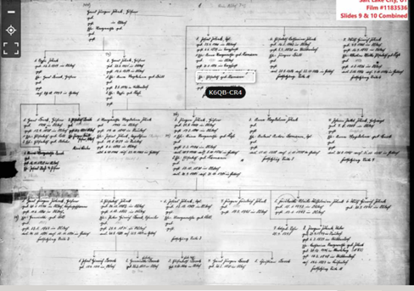
German Compiled Genealogies
Notes:
Welcome to Webinar number seven on German compiled genealogies.

Slide 2
Webinar 7 – German Compiled Genealogies
Compiled Genealogy Resources 3
Internet Resources 4
FamilySearch Resources 12
Periodical Resources 17
German Genealogical Collections 53
Family Histories 54
Deutsche Geschlechterbücher or German lineage Books 62
Deutsches Familienarchive or German Family Archives 75
Ahnenstammkartei or Ancestral Pedigree Index 82
Ortssippenbücher or Locality lineage books 93
Mappenstücke a collection of documents on thousands of family lines 114
Leichenpredigten or Funeral Sermons 122
Coat of Arms 151
Notes:
In this lecture I will be covering some specific topics. The beginning slide number for each topic is given on the right. First, we will talk about…
*Compiled Genealogy Resources that include 3
*Internet Resources 4
*FamilySearch Resources and 12
*Periodical Resources 17
Next, we will talk about…
*German Genealogical Collections including 53
*Family Histories 54
*Deutsche Geschlechterbücher German lineage
Books 62
*Deutsches Familienarchive or German Family
Archives 75 *Ahnenstammkartei or Ancestral Pedigree Index 82
*Ortssippenbücher or Locality lineage books 93
*Mappenstücke a collection of documents on
thousands of family lines 114
*Leichenpredigten or Funeral Sermons 122
Last of all we will talk about…
Finding a Coat of Arms 151
if you should tie into a nobility line.

Slide 3
Compiled Genealogies
Extending German ancestral lines
Prevent duplication of research
Notes:
In this lecture I will talk about using compiled genealogy resources to *extend German ancestral lines and *prevent duplication of family research.
Many genealogists do not realize that they may be duplicating family research that has already been completed by someone else.
The further we extend an ancestral line, the greater the likelihood that someone has connected to it and extended it even further.
One time at the Salt Lake FamilySearch Library, a patron came in wanting to know if her line could be extended back further if she hired a researcher. She gave her earliest ancestor’s name, his date, and place of birth. I went over to the book stacks and checked some compiled genealogy resources that I will be talking about in this lecture. After a couple of minutes I returned with a periodical volume and opened it up to an article that listed her very ancestor. The author of the article had extended the line back several generations in Germany and on back to the origin of the family in the Netherlands.

Slide 4
Internet Resources
Notes:
First, I want to talk about internet resources.

Slide 5
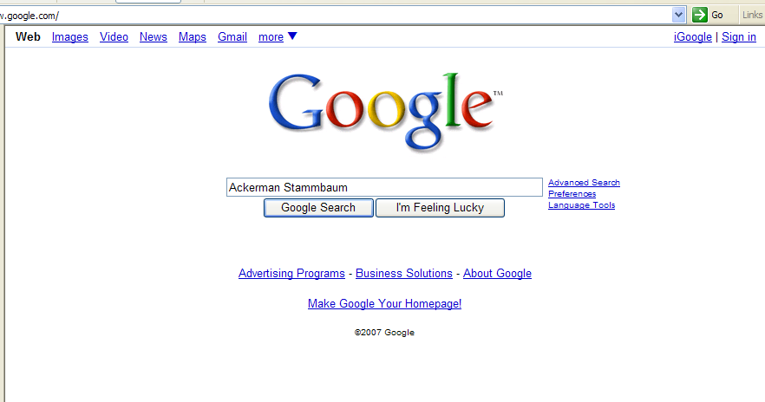
Notes:
I was helping someone who was searching for an ancestor by the name of Engelke Ackerman. Out of curiosity I did a google search for Ackerman Stammbaum (pedigree).

Slide 6
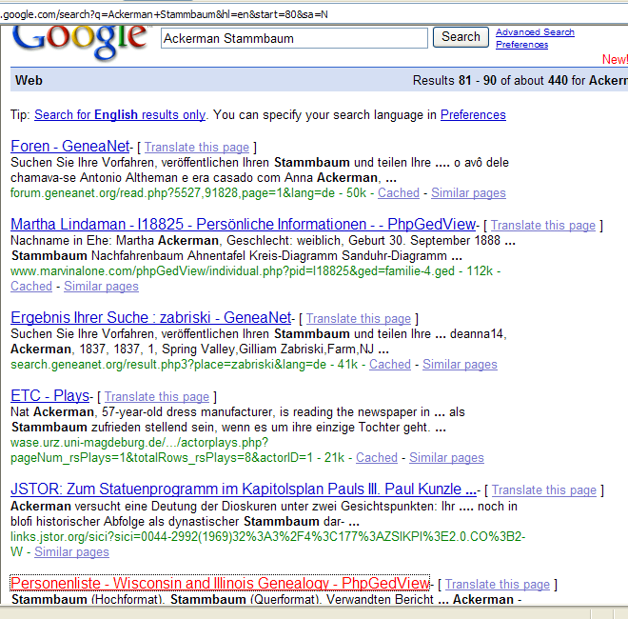
Notes:
In checking several entries, I came across this Personenliste at the bottom.

Slide 7
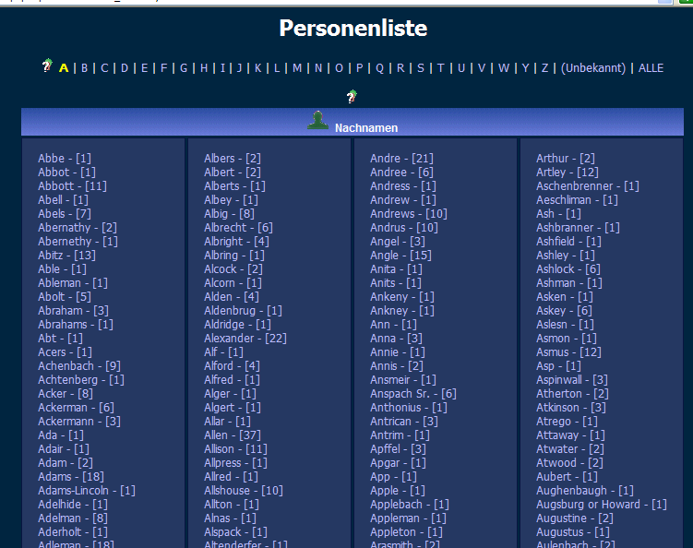
Notes:
Clicking on it, it took me to a Surname List. *On the list there were three entries for Ackerman.

Slide 8
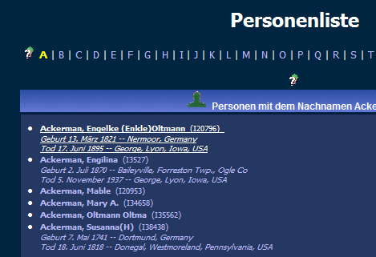
Notes:
One of the entries was for an Engelke Ackermann born 13 March 1821 at Nermoor, Germany and died 17 June 1895 at George, Lyon, Iowa, USA, which matched the patron’s ancestor.

Slide 9
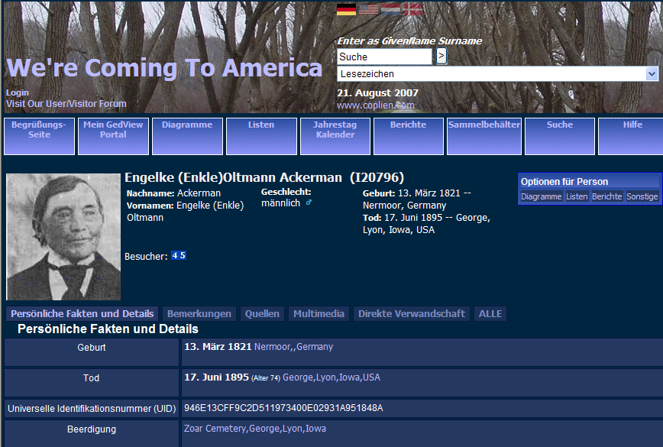
Notes:
In clicking on the entry, it brought up his picture and more information. It also brought up other *options for this person.

Slide 10
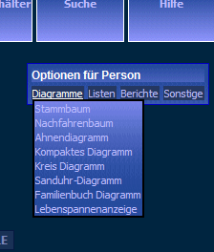
Notes:
In clicking on it. it shows that there was a *pedigree chart for him.

Slide 11
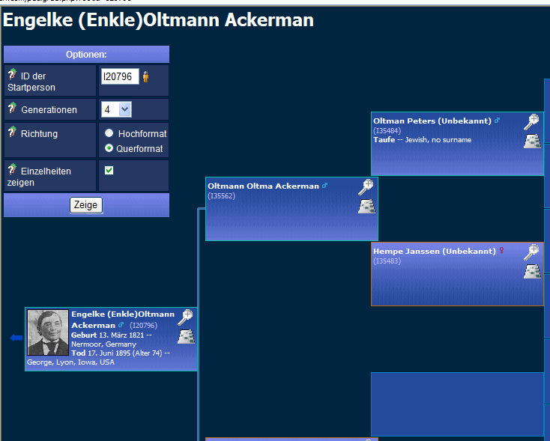
Notes:
The pedigree went back two more generations.

Slide 12

Accessing FamilySearch Resources
Notes:
Accessing FamilySearch Resources

Slide 13
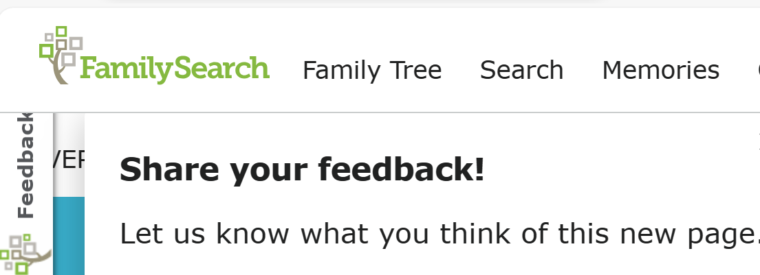
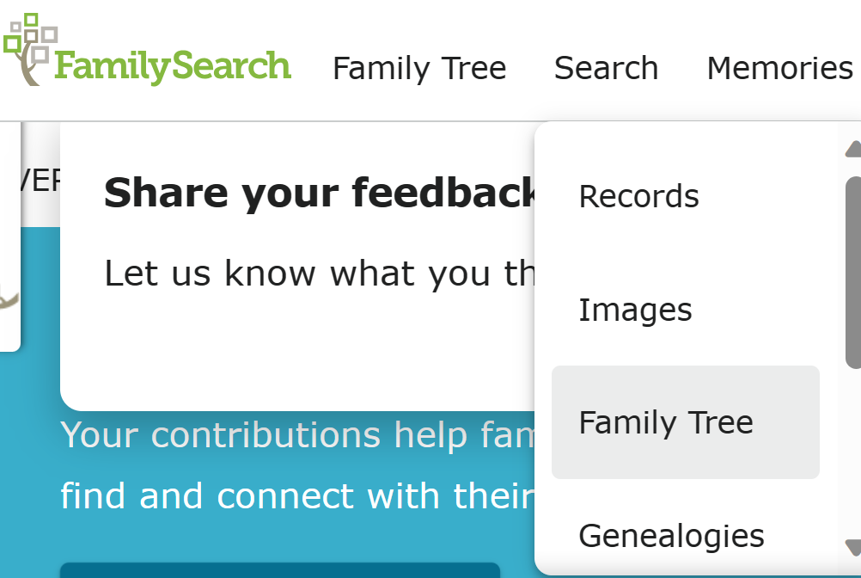
Notes:
After logging onto FamilySearch, Click on the *“Search” tab.
*Then from the dropdown box, click on the *“Genealogies” tab.

Slide 14
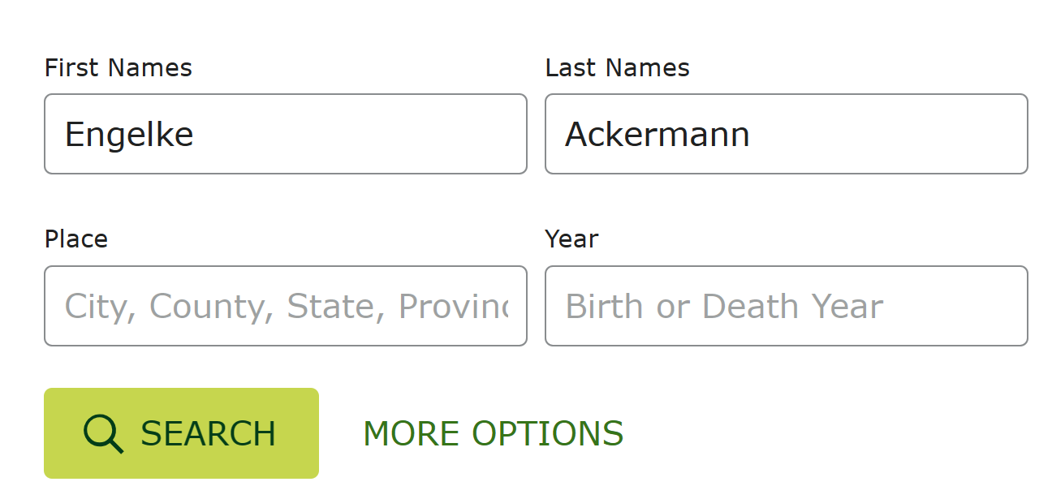
Notes:
Fill in the first and last name of the individual you are searching for. In this example I am using the same person we found on the internet.

Slide 15
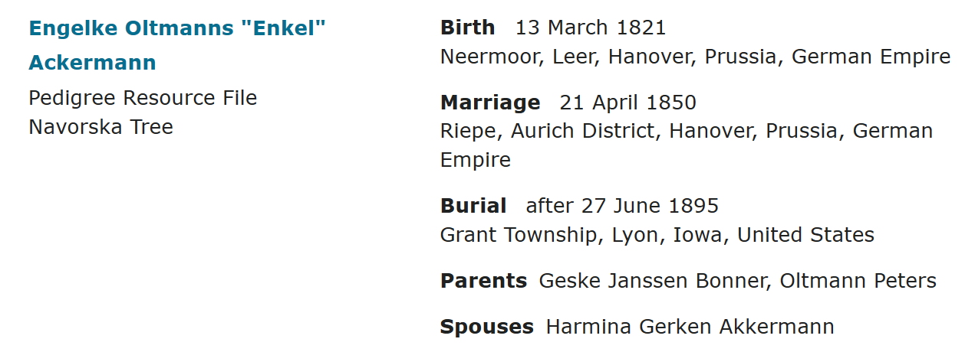
Notes:
Under the name tab, it gives us his full name including another version of his given name. This information was found in the *Pedigree Resource File connected to a Navorska family tree.
Under the Events tab, it provides information on the date and place of birth, marriage, and burial. The names of his parents and spouse are also included on this FamilySearch site.

Slide 16
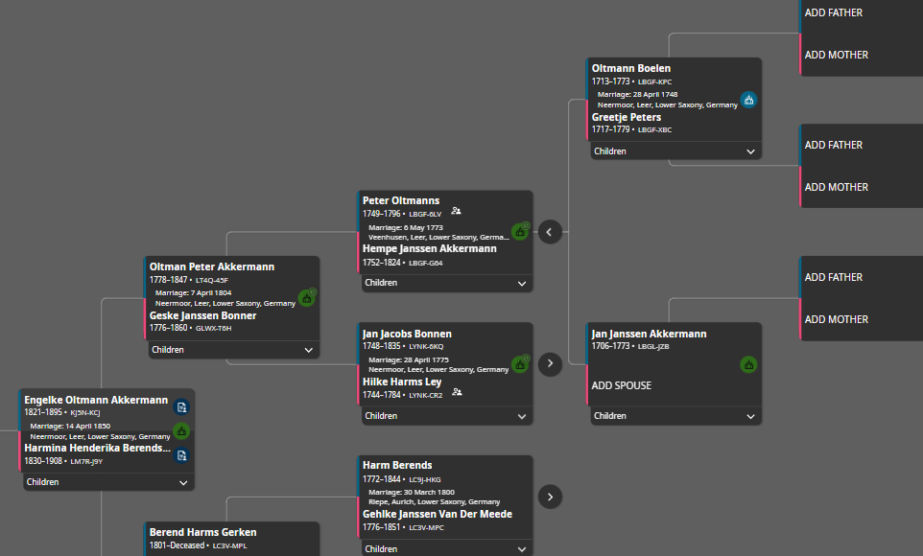
Notes:
By clicking on his FamilySearch tree, it takes us to a pedigree chart which only goes back to his great grandparents on his father’s side.

Slide 17
Periodical Resources
1500 – Mid-1800
Published genealogies for nobility and Upper Class
1848 – Early 1900’s
Published Genealogies for all Classes
German Genealogical Societies
Formed after World War I
Creation of German periodicals for people to publish their genealogies, pedigrees & histories
Notes:
Periodical Resources
Next, I want to talk about periodical resources and the use of German periodical indexes and periodicals.
From the 1500’s to the mid-1800’s published genealogy works identified nobility and the upper-class people. Between 1848 and the early 1900’s, genealogy became popular in all classes in Germany. German Genealogical societies began to be formed after World War I. These societies began publishing genealogical periodicals in order for society members and others to share genealogical information. People from all over Germany began submitting their family histories, their pedigrees, and their genealogies to be published in these periodicals.
How many German periodicals are there? A study determined there are over 600 German periodicals found throughout what was the former German empire area. Each of the periodicals had between 20-60 volumes. Even if there were an average of 30 volumes, if we time it by 600, that would be 18,000 volumes. That is quite a haystack of volumes to go through to find a family history needle.

Slide 18
Periodical Indexes
      Familiengeschichtliche Quellen (family history sources)
      Der Schlüssel (the key)
      Quellenschau für Familienforscher (show of sources for family research)
Notes:
Using German Periodical Indexes
Many of the periodicals have been indexed in one or more of the following periodical indexes:
Familienforscher (show of sources for family research).
Familiengeschichtliche Quellen (family history sources)
Der Schlüssel (the key).
Quellenschau für.
Der Schlüssel (the key).
Quellenschau für Familienforscher (show of sources for family research).’

Slide 19
Importance of German Periodicals:
(Information Found in German Periodicals)
Family histories
Compiled genealogies
Pedigree charts (ascending and descending)
Solutions to genealogical research problems
      Extracted records
Notes:
The importance of German periodicals and periodical indexes.
The following are types of genealogical material found in periodicals:
Family histories
Compiled genealogies
Pedigree charts (ascending and descending)
Solutions to genealogical research problems
and Extracted records

Slide 20
Family Histories Found in Printed Sources
The following are examples of Using Periodical Indexes & Periodicals
Notes:
Family Histories in Printed Sources
Finding a family history begins by searching these three periodical indexes of sources of surnames and family histories.
The following are examples of using these.

Slide 21
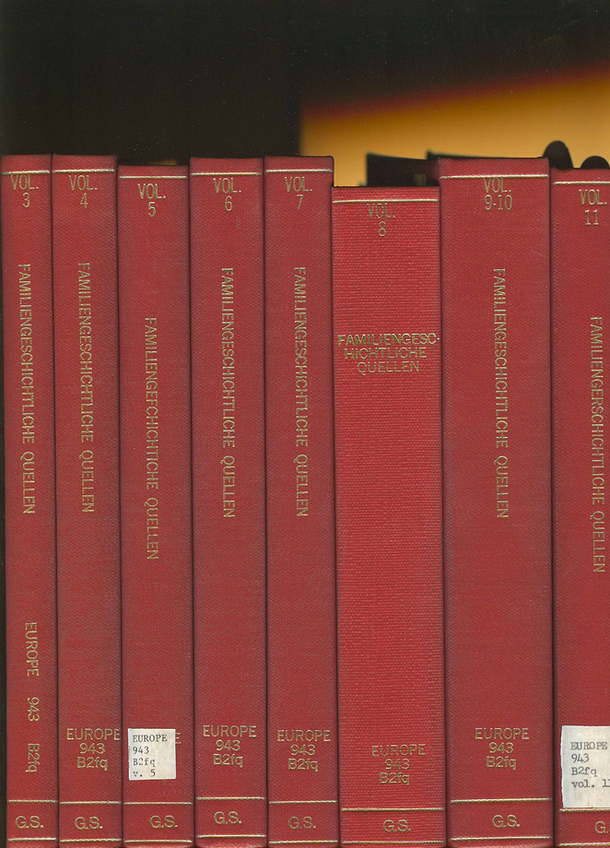
Familiengeschichtliche Quellen
Family History Sources
Notes:
The Familiengeschichtliche Quellen, or *Family History Sources is a 19-volume surname index of hundreds of German periodicals. It is an index of every surname listed in every periodical included in the nineteen volumes.

Slide 22
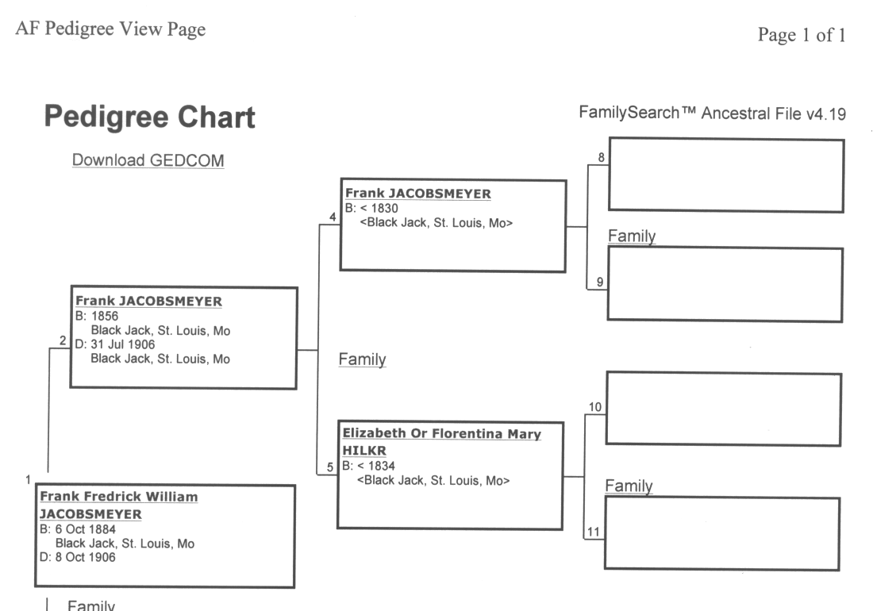
Jacobsmeyer
Pedigree Chart
Notes:
A person came to the Library looking to find information on their immigrant ancestor Frank Jacobsmeyer, who settled in St. Louis, Missouri. The family had not been able to determine where he came from in Germany.

Slide 23

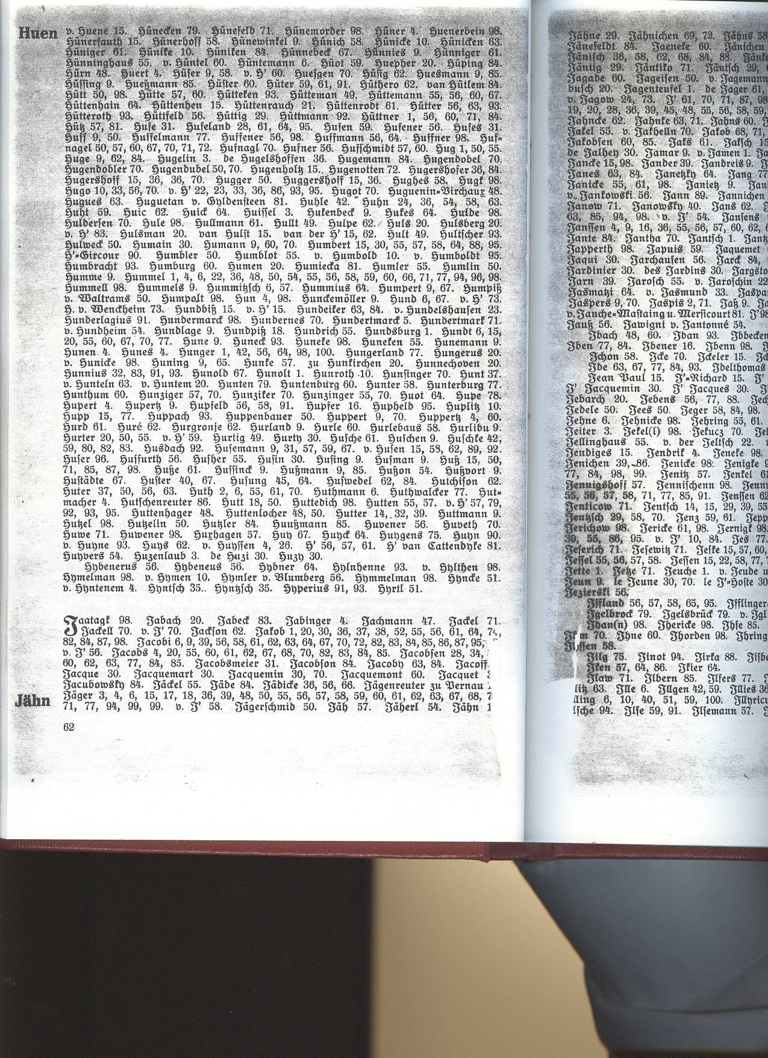
Jacobsmeier
Familiengeschichtliche Quellen, vol. 3
(Family History Sources)
Notes:
They found their surname listed in volume three of the Familiengeschichtliche Quellen. Following the name was the reference number 31.

Slide 24
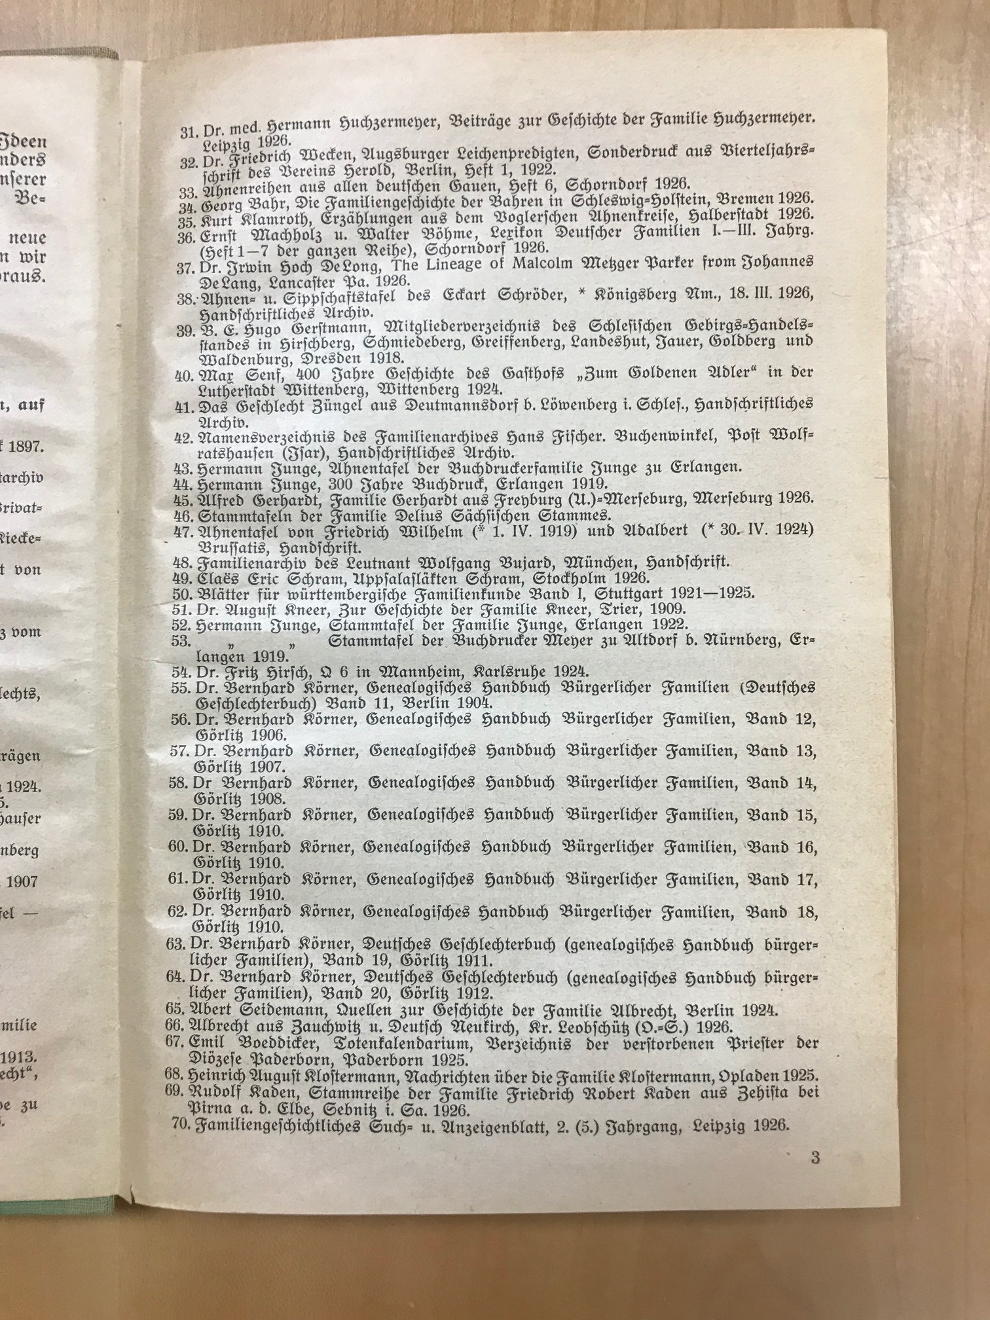
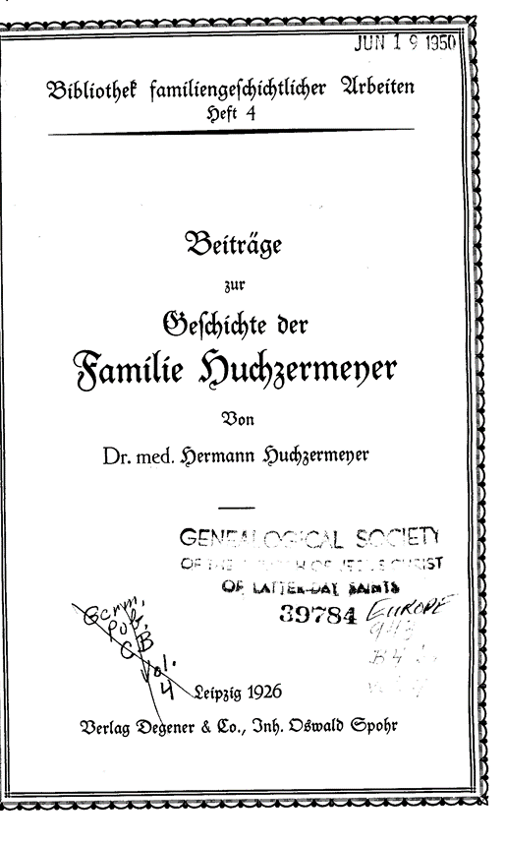
Huchzermeyer Family History
Notes:
Turning to the front of the volume, all of the references are listed numerically. Number 31 was a family history on the Huchzermeyer Family.

Slide 25
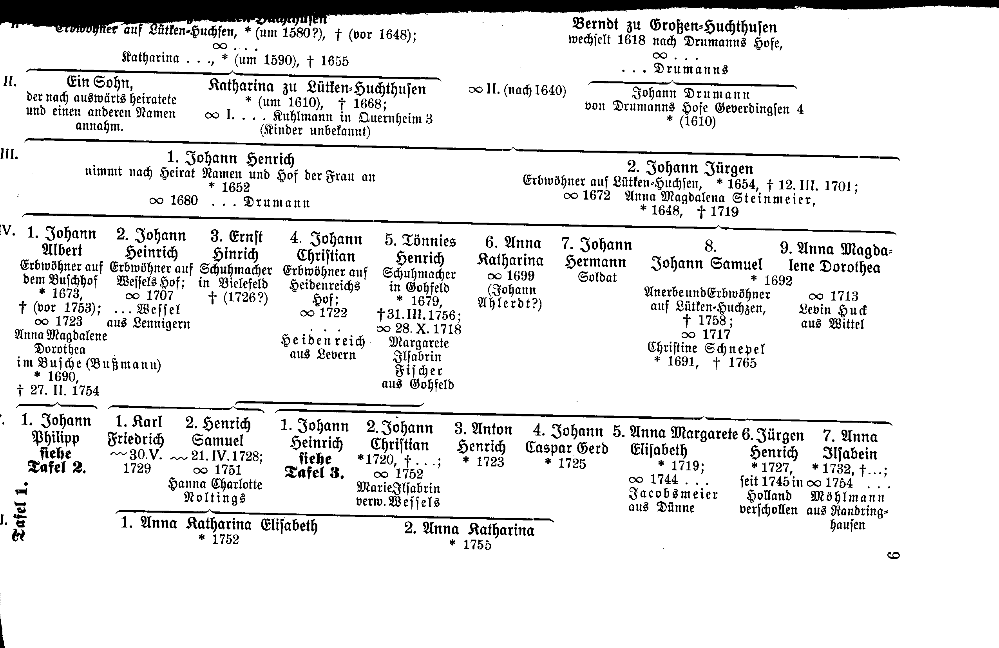
Huchzermeyer Descending Pedigree Chart
Jacobsmeier
From Dünne, Westfalen
Notes:
An index at back of this family history book, identified the page with a Huchzermeyer descending pedigree that listed a Jacobsmeier from Dünne. Dünne is in the Minden County of the Prussian province of Westfalen.

Slide 26

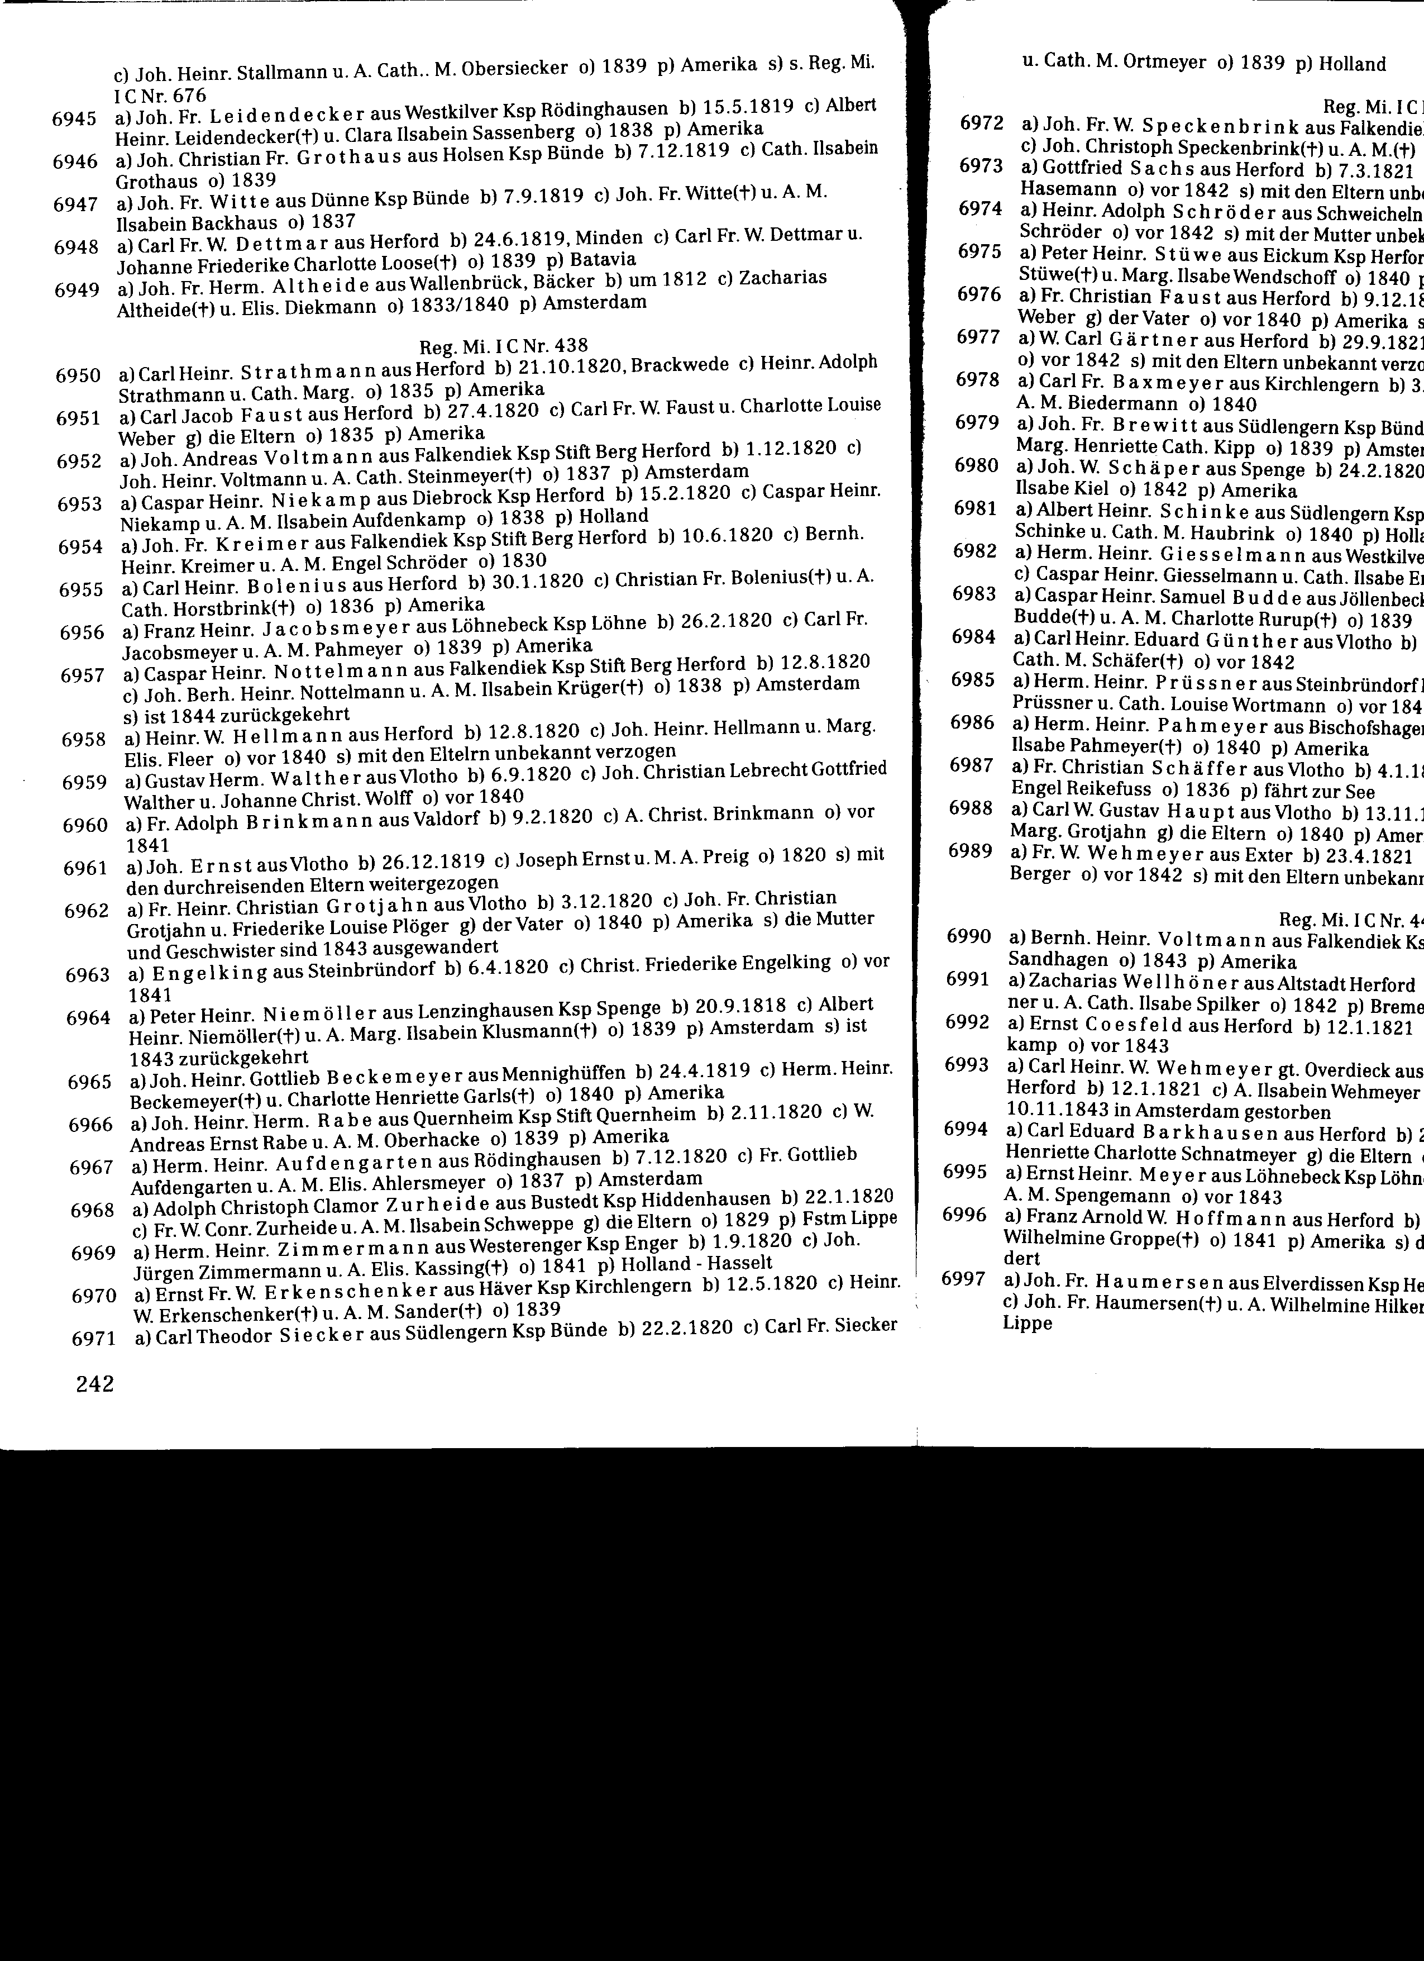
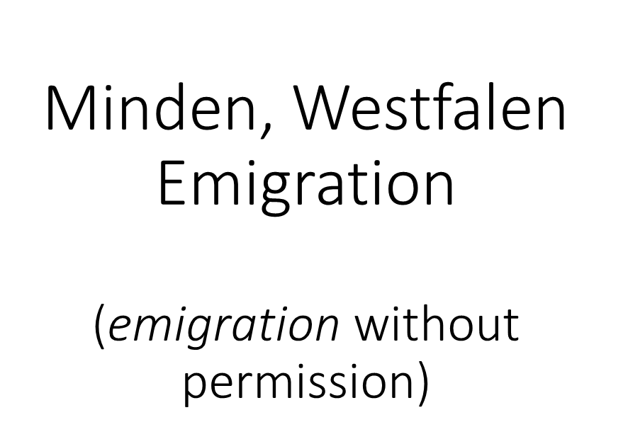
Emigration Record of
Franz Heinrich Jacobsmeyer
Notes:
Franz, or Frank, Heinrich was found in the Minden County emigration records showing he was born in the parish of Löhne on 26 February 1820.

Slide 27
Notes:
This record gives his father’s name as Carl Friedrich Jacobsmeyer, his mother as A. M Pahmeyer, and Franz, who emigrated *in 1839.

Slide 28
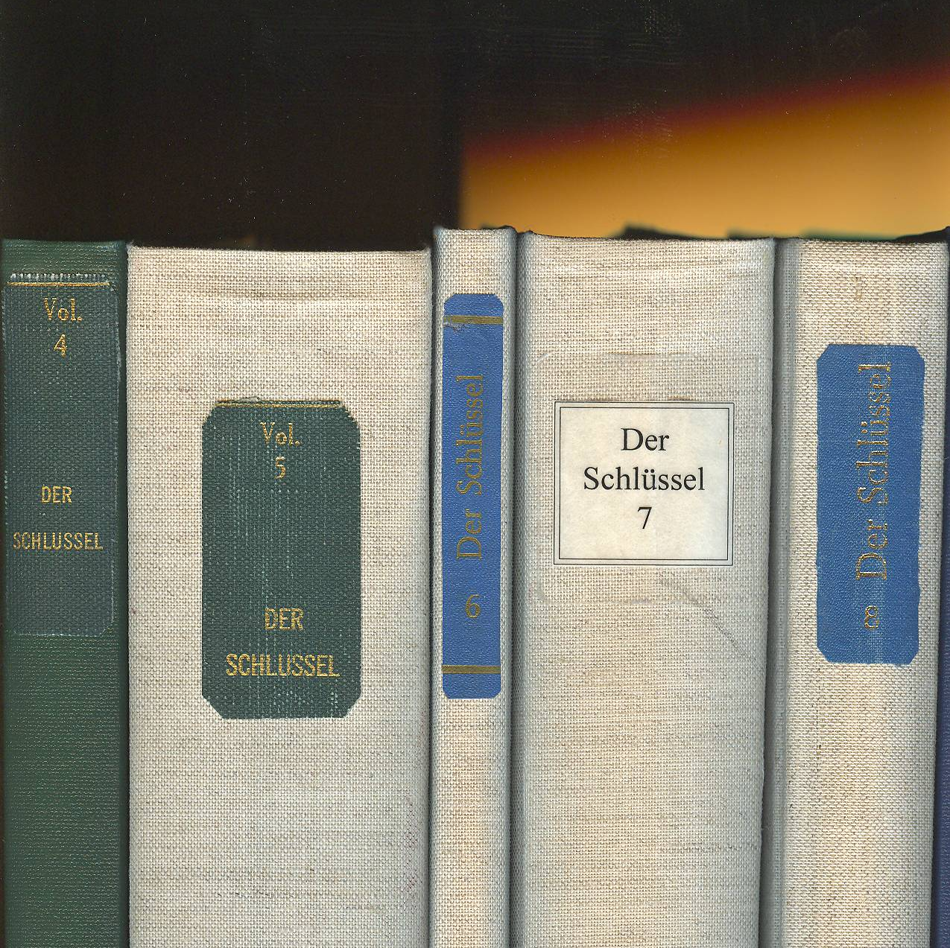
Periodical Index –
Der Schlüssel
Notes:
This next example in taken from the periodical index called der Schlüssel (the key). It is a nine-volume work.

Slide 29
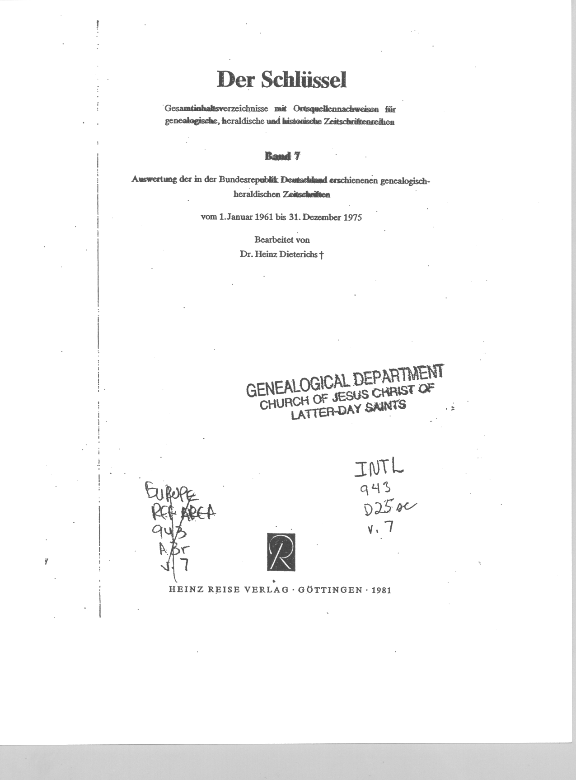
(The Key)
Includes:
Locality index
Subject index
&
Surname index
Notes:
Each volume of der Schlüssel has a locality index, a subject index and a surname index.

Slide 30
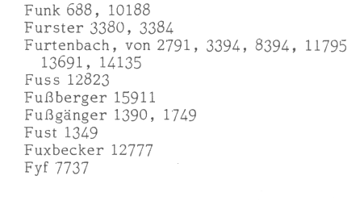
Surname Index is Author/Title Only
Notes:
The indexes are author and title only. That means that only those names, subjects and localities that are in the title along with the names of the authors, are indexed. If there are other names, subjects, and localities listed in an article, they will not be indexed.
In this example we have the surname *“Fust” and the item number is *1349.

Slide 31
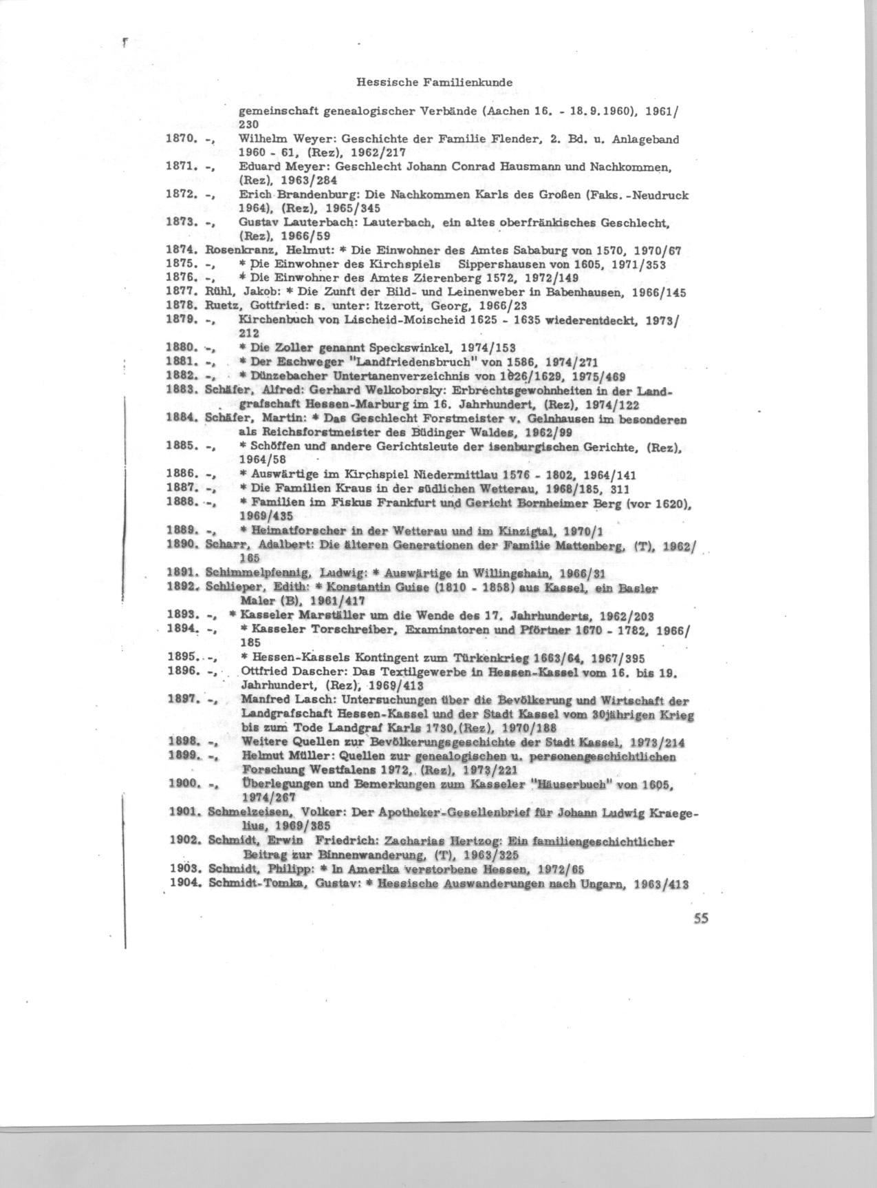
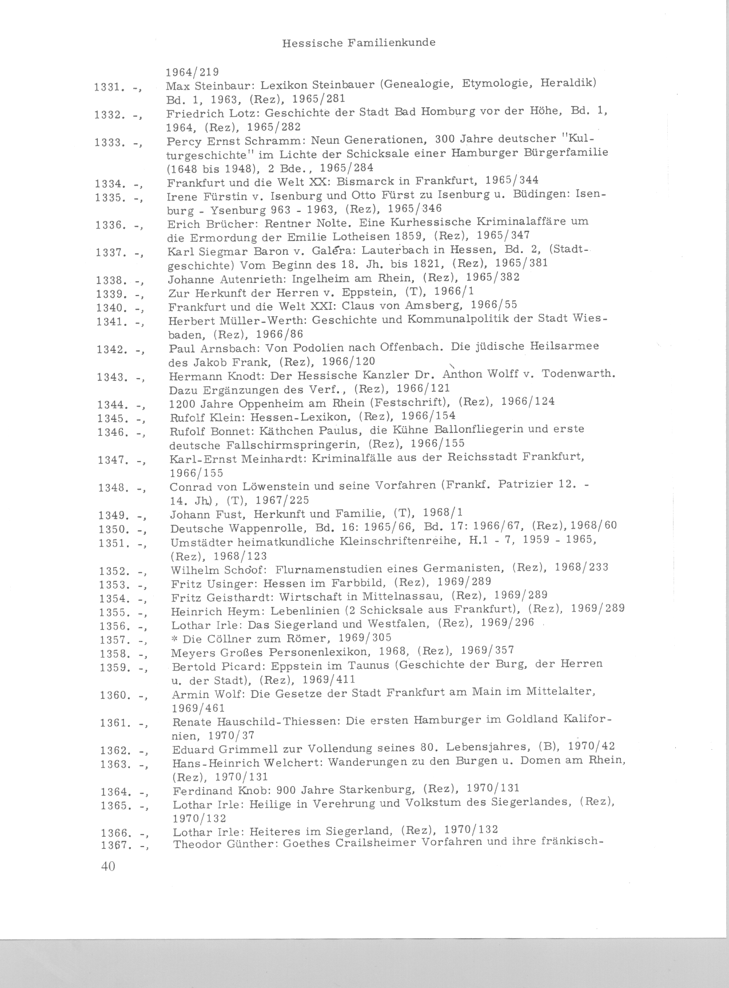
Notes:
In the front of each volume each entry is in numerical order, which makes it easy to find the one you need.

Slide 32
1. Name of the periodical
1.
Notes:
There are four things to look for when using this resource.
First
The name of the periodical that the article is in is given at the top of the page. For this one it is the Hessische Familienkunde or Hessen Family information.

Slide 33
2. Name of Author & Title of Family History
2.
Notes:
Second
The name of the author and the title.
The name of the author can be important because they often write other articles about the same family or the same town or area. By checking the surname index for the author’s surname, you may find additional information.

Slide 34
3. Year the article was published
3.
Notes:
Third
The year following the title is the year that this article was published in this periodical. The years act as volumes. This volume is 1968.

Slide 35
4. Page on which the Family History appears
4.
Notes:
Fourth
Is the page number that the article is on. This article is on page 1.

Slide 36
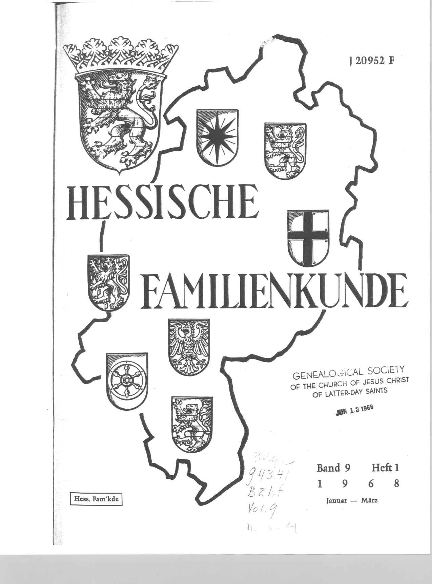
Title Page from the Periodical
Notes:
This is the title page for the 1968 volume.

Slide 37
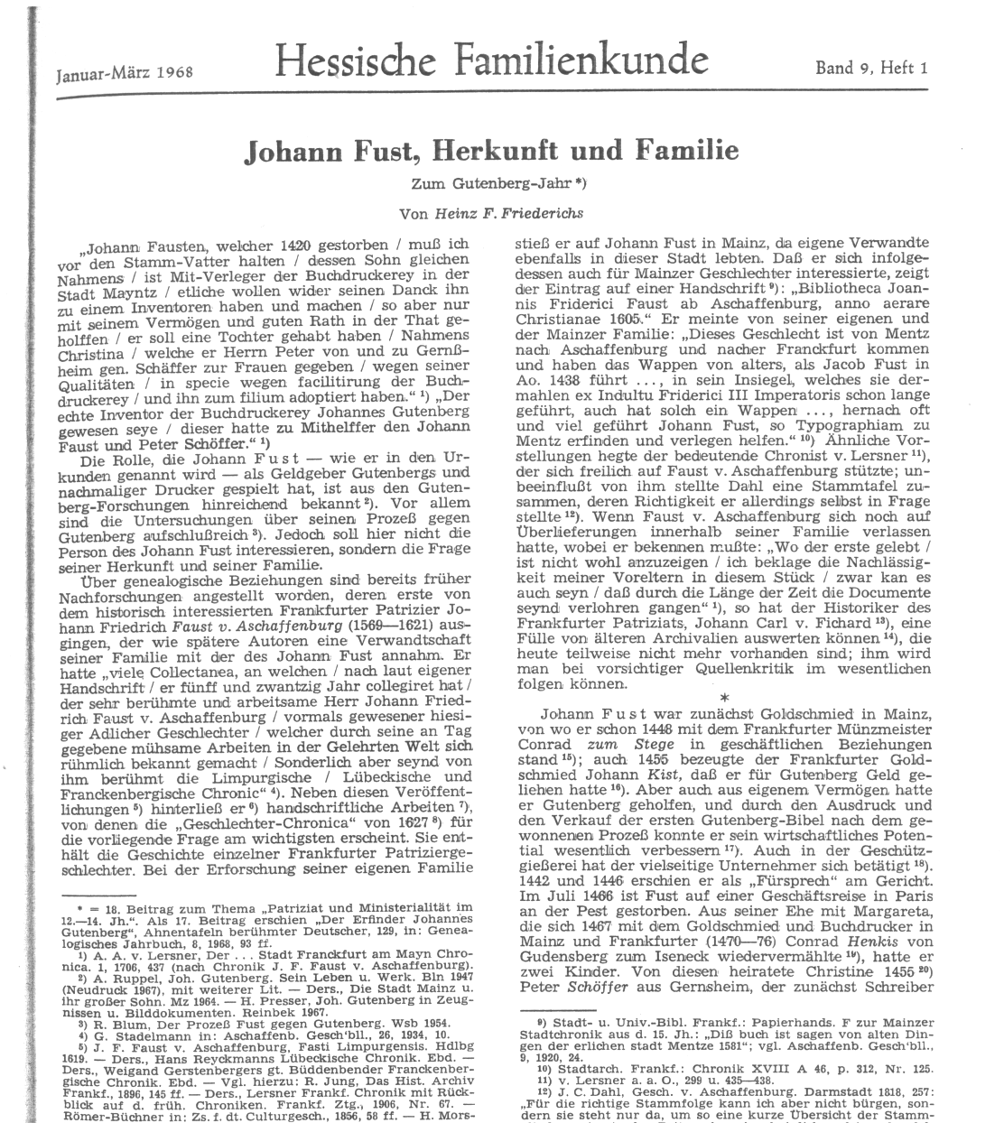
Year: 1968
Page 1
Notes:
And this is page one of the article on the Fust Family.

Slide 38
Quellenschau für Familienforscher
A Show of Sources for Family Researchers
Notes:
The Quellenschau für Familienforscher means a show of sources for family researchers. It is a three -volume work, outlined here in red.

Slide 39
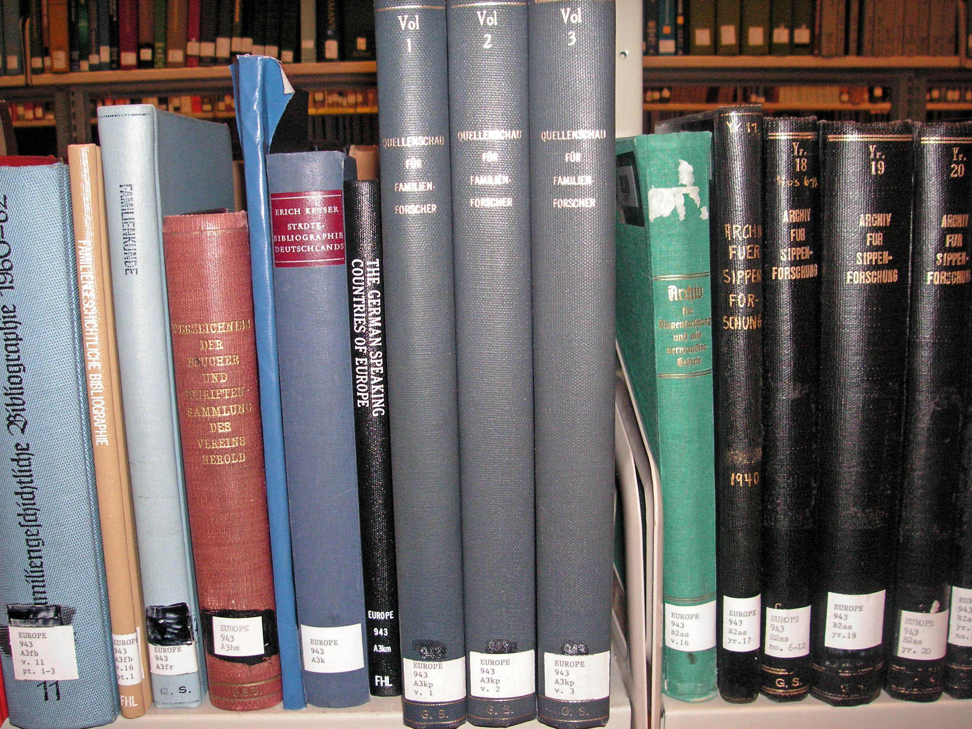
Quellenschau für Familienforscher
Notes:
The Quellenschau für Familienforscher means a show of sources for family researchers. It is a three -volume work, outlined here in red.

Slide 40

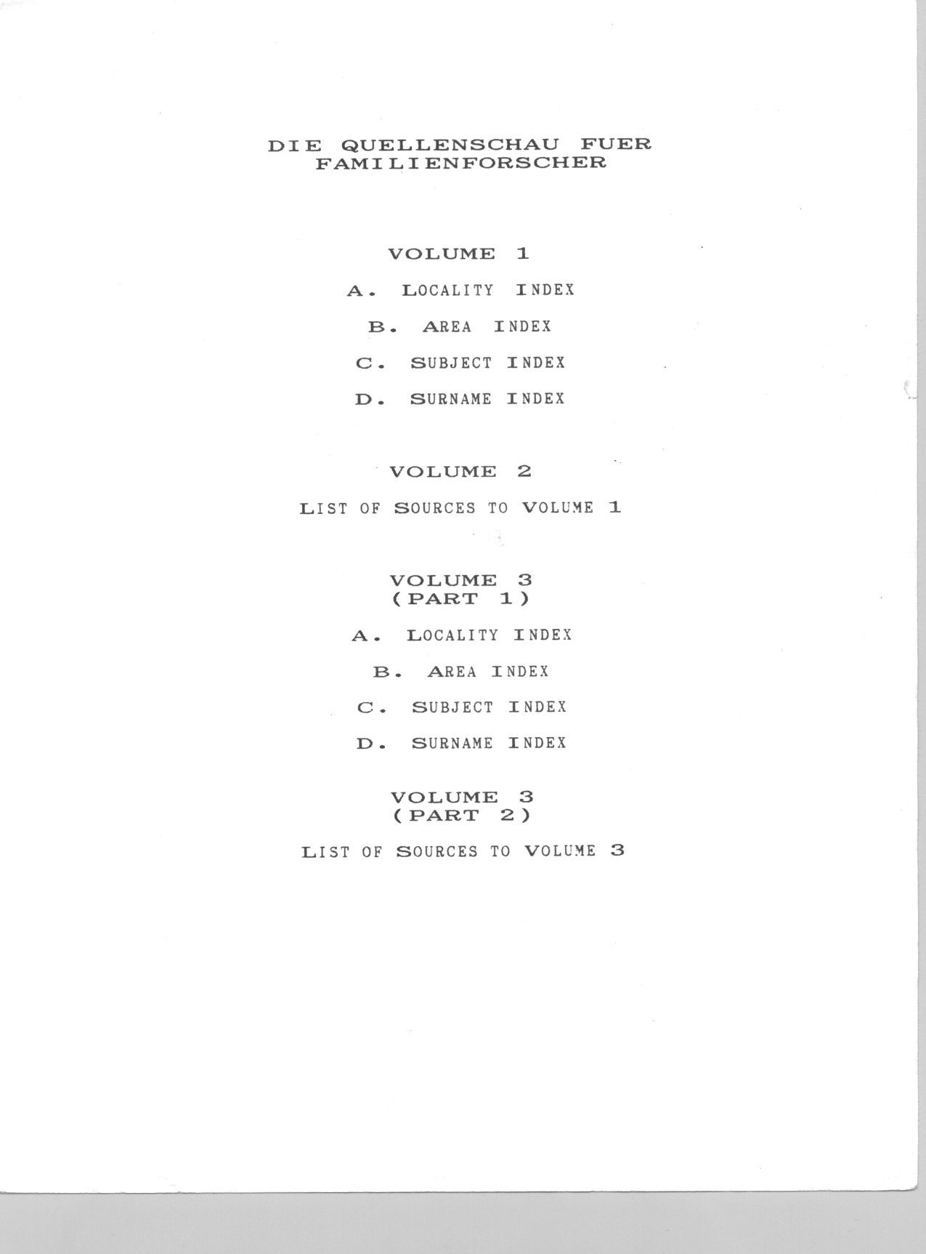
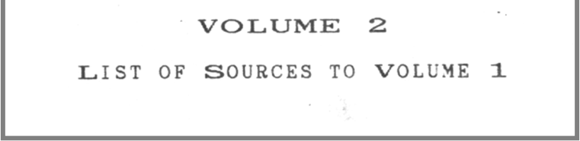
Notes:
*Volume one lists four indexes. The locality index is an index of cities and towns,
The area index is an index of areas such as nobility, government, and cultural areas.
The subject index is an index of subjects such as occupations, schools, and record types.
The last index is the surname index.
*Volume two is a list of sources pertaining to volume one.
*Volume three is in two parts.
Part one contains the locality, area, subject, and surname indexes.
Part two provides a list of sources for part one in volume three.

Slide 41
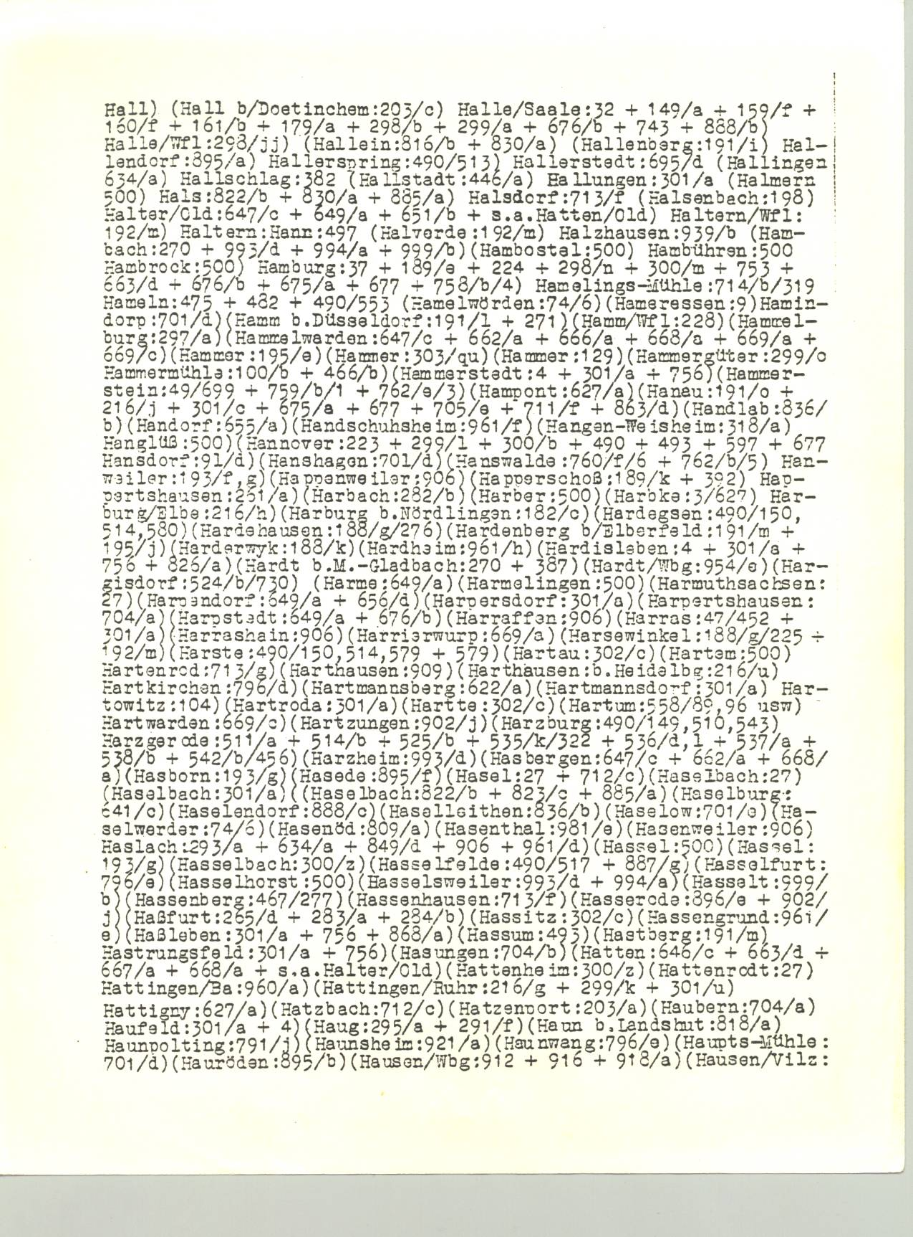
Locality Index
Notes:
In the locality index the cities and towns are listed alphabetically across the page, making it a little more difficult to search.
The reference numbers after each locality are the numbers that identifies the sources that were indexed.

Slide 42
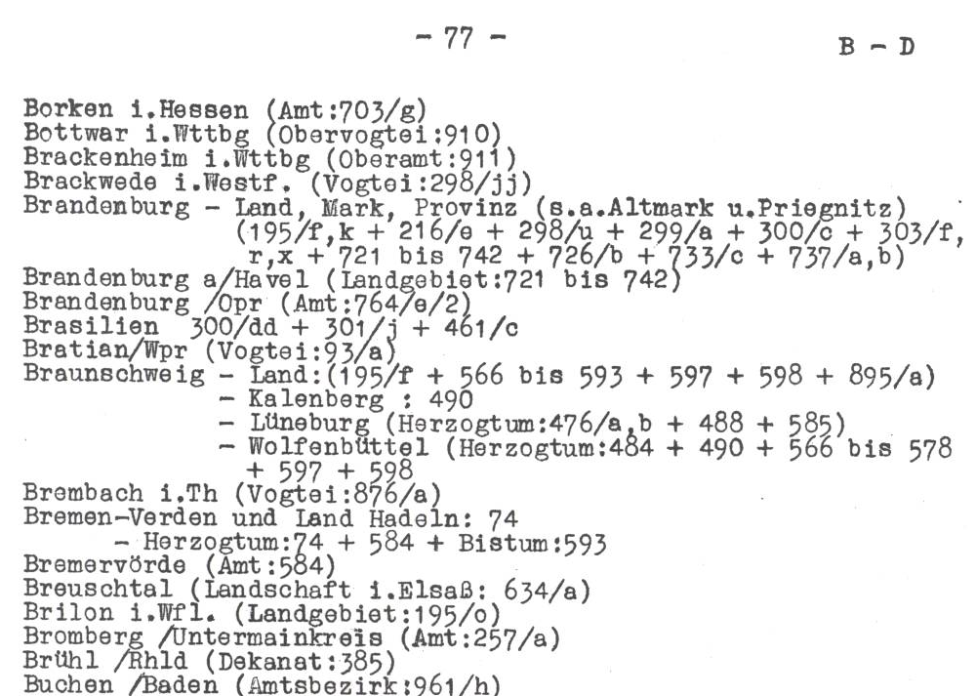
Area Index
Notes:
The Area Index is easy to search but you must first know & understand the government and area jurisdiction in order to effectively use it. These were discussed in Webinar No. two.

Slide 43
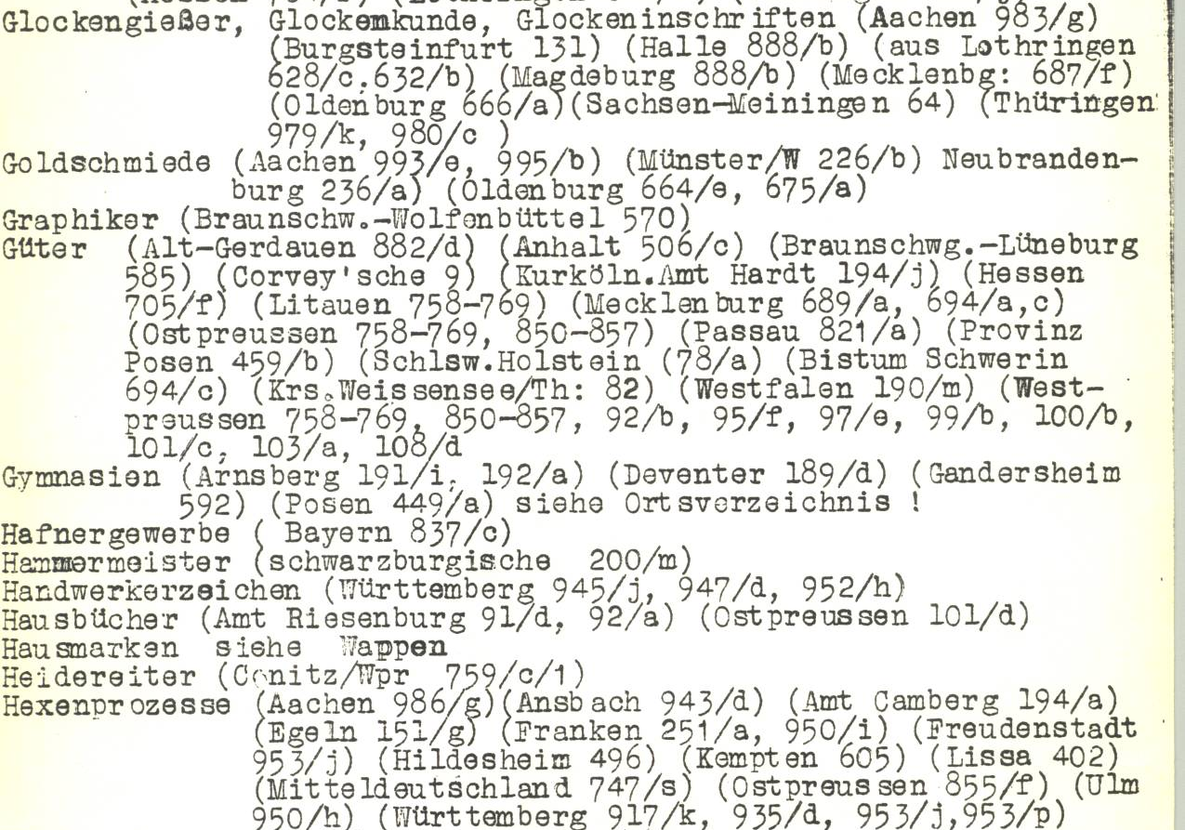
Subject Index
Notes:
The Subject Index identifies the place or jurisdiction to which it pertains.

Slide 44
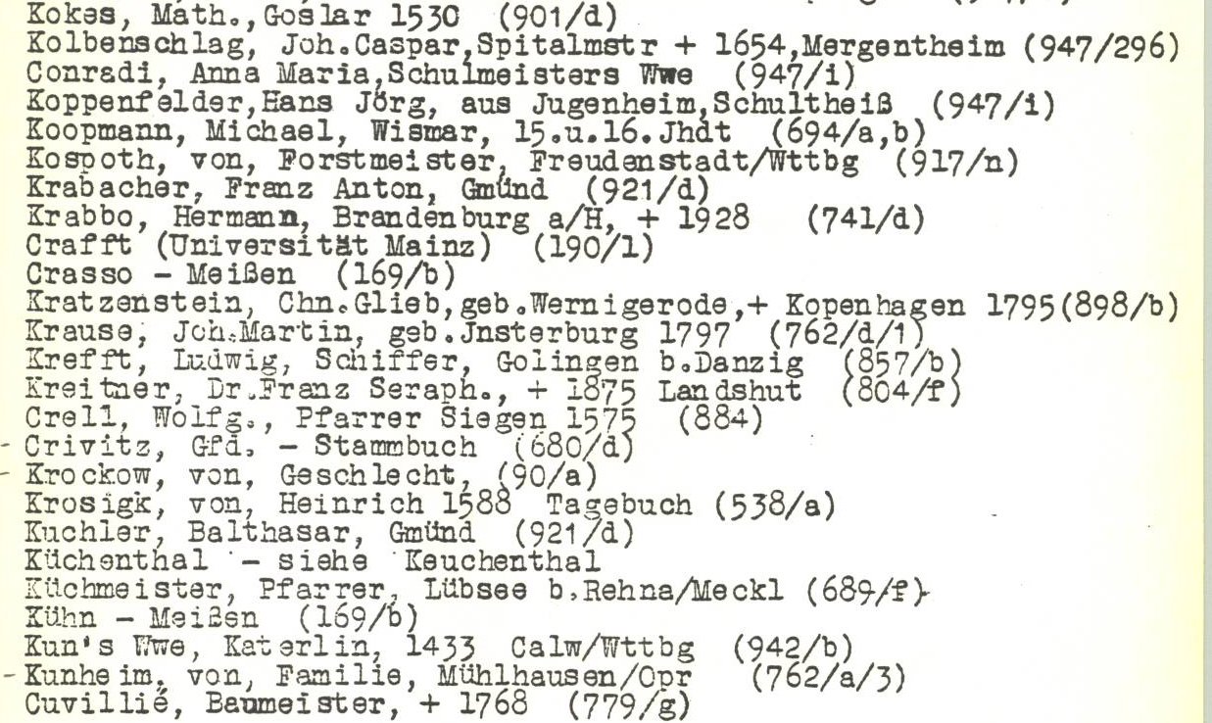
Surname Index
Notes:
In the surname index, some of the names are listed phonetically. For example, the names beginning with a “C” are listed with those that begin with a “K”.

Slide 45
Nahrgang Family
No record in the U.S. gave anything except Germany as the place of origin.
German surname books did not list the Nahrgang name.
The name may have been anglicized after they arrived in America.
Notes:
Another time I was helping a patron at the FamilySearch Library who was trying to determine where his Nahrgang family came from in Germany. *He hadn’t been able to find any record in the U.S. that gave anything other than Germany. *German surname books at the library did not list the Nahrgang name either. *It was possible that the name may have been anglicized after they came to America.

Slide 46
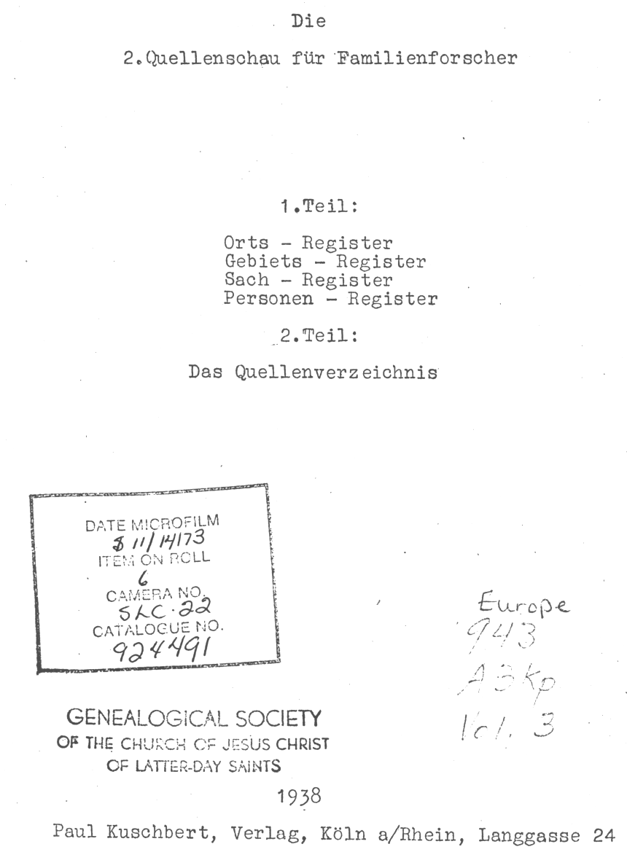
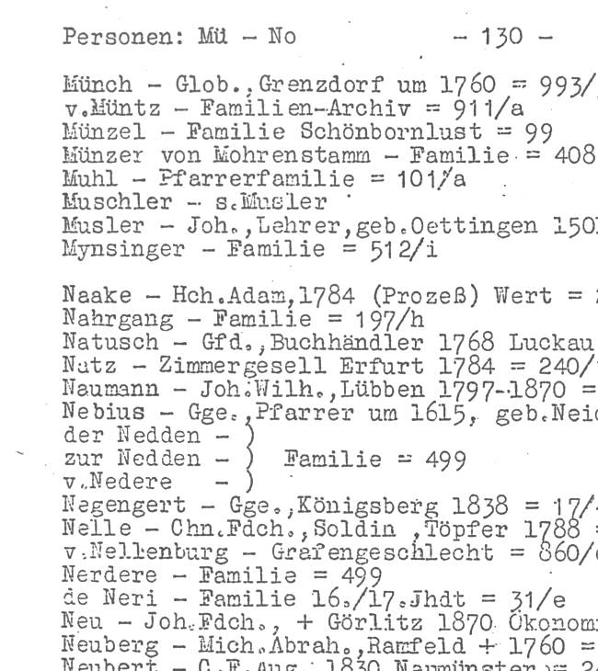
Notes:
In the Quellenschau für Familienforscher, *under Personen Register, we found an entry that listed the *Nahrgang Family and gave the source number *197/h

Slide 47
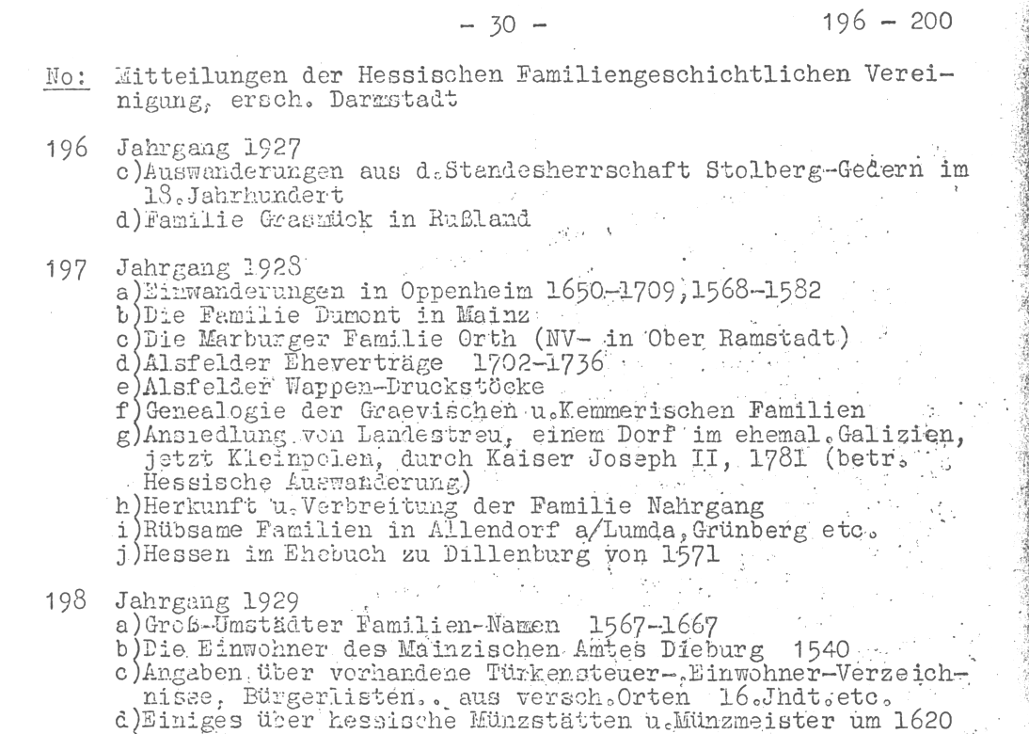
Origin and distribution of the Nahrgang family name
Notes:
In volume two the source *number 197 that pertained to the volume for 1928 was found. The periodical articles in this volume were listed from 197/a – 197/j. *Entry 197/h was titled Herkunft und Verbreitung der Familie Nahrgang or *Origin and distribution of the Nahrgang family name. At the *top of the page the name of the periodical was given as Mitteilungen der Hessischen Familiengeschichtlichen Vereinigung or Messages of the Hessen Family History Society.

Slide 48
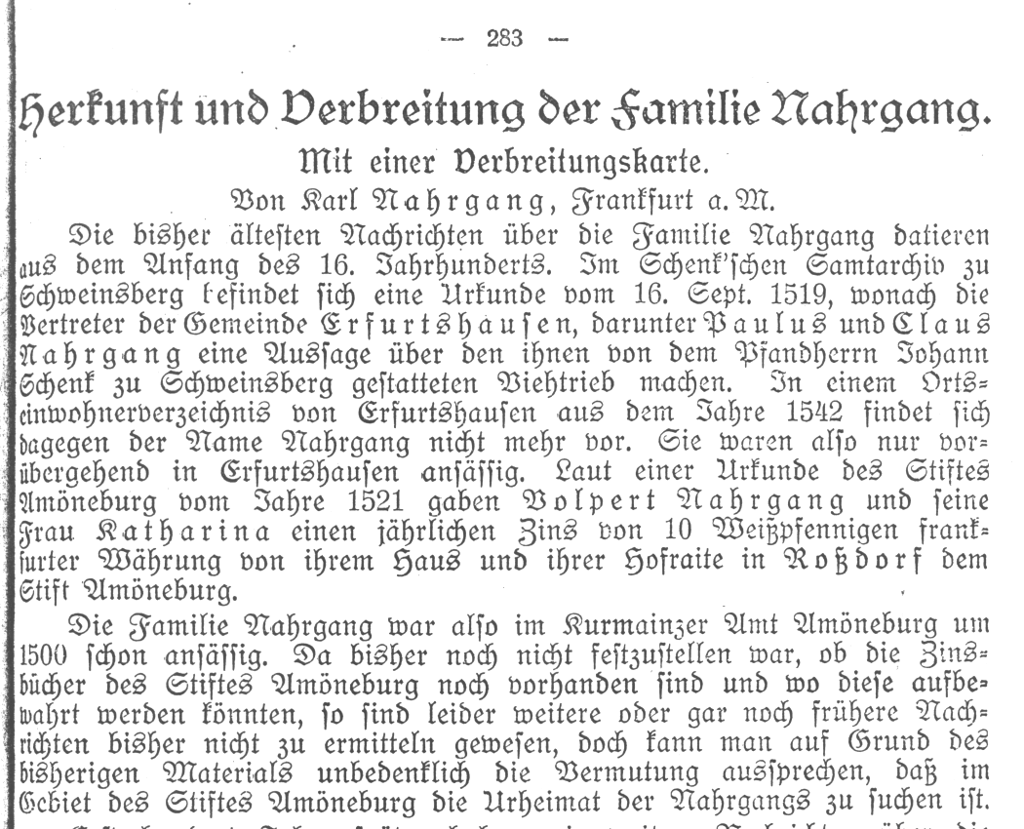
Notes:
This is the article on the Nahrgang family.

Slide 49
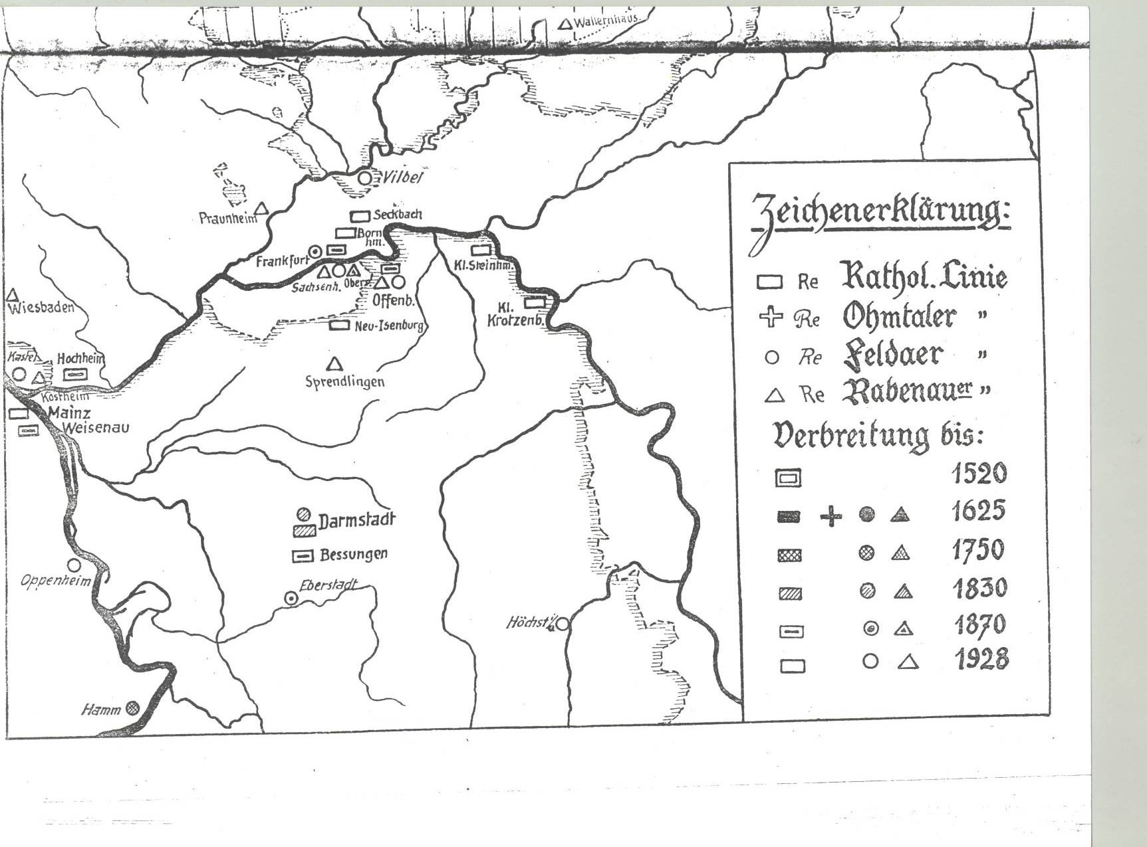
Notes:
This map shows the distribution of the Nahrgang family between 1520 and 1928.

Slide 50
Webinar lectures on using German periodicals & periodical indexes.
1. Use of the Periodical index – Der Schluessel.
2. Use of the Periodical indexes – Quellenschau fuer Familienforscher & Familiengeschichtliche Quellen
3. Understanding German Locality Jurisdictions
4. Searching unindexed periodicals, using periodicals and the FamilySearch Library Catalog, Searching digitized and Online periodicals
These were presented and recorded online for the BYU Library.
Notes:
In 2020, the following four webinar lectures were created on using German periodicals & periodical indexes:
1. Use of the Periodical index – Der Schlüssel.
2. Use of the Periodical indexes including the – Quellenschau für Familienforscher and the Familiengeschichtliche Quellen
3. Understanding German Locality Jurisdictions
4. Searching unindexed periodicals, using periodicals and the FamilySearch Library Catalog, and searching digitized and Online periodicals
These lectures were presented and recorded online for the BYU Library Family History Center or BYU Library for short.

Slide 51
Instructions on accessing BYU Webinar lectures on using German Periodicals and Periodical Indexes
Notes:
Instructions for accessing BYU Webinar lectures on using German Periodicals and Periodical Indexes.

Slide 52


To access the four-lecture series, click on the following website:
  Webinar Library | BYU Family History Library | BYU Library ...
fh.lib.byu.edu › online-webinars › webinar-recording-index
Under:
Click on:
Near the bottom of the list are the four lectures on
Using German Periodicals and Periodical Indexes
Notes:
To access the four-lecture series, click on the following website:
Webinar Library | BYU Family History Library | BYU Library ...
fh.lib.byu.edu › online-webinars › webinar-recording-index
Under: Webinar Categories
Click on: Foreign Country Webinars
Near the bottom of the list are the four lectures on
Using German Periodicals and Periodical Indexes

Slide 53
German Genealogical Collections
Notes:
German Genealogical Collections
Whenever I was assisting patrons with their German research at the FamilySearch Library in Salt Lake, I would always ask if they had checked the following:

Slide 54
Family Histories
Notes:
Family Histories

Slide 55
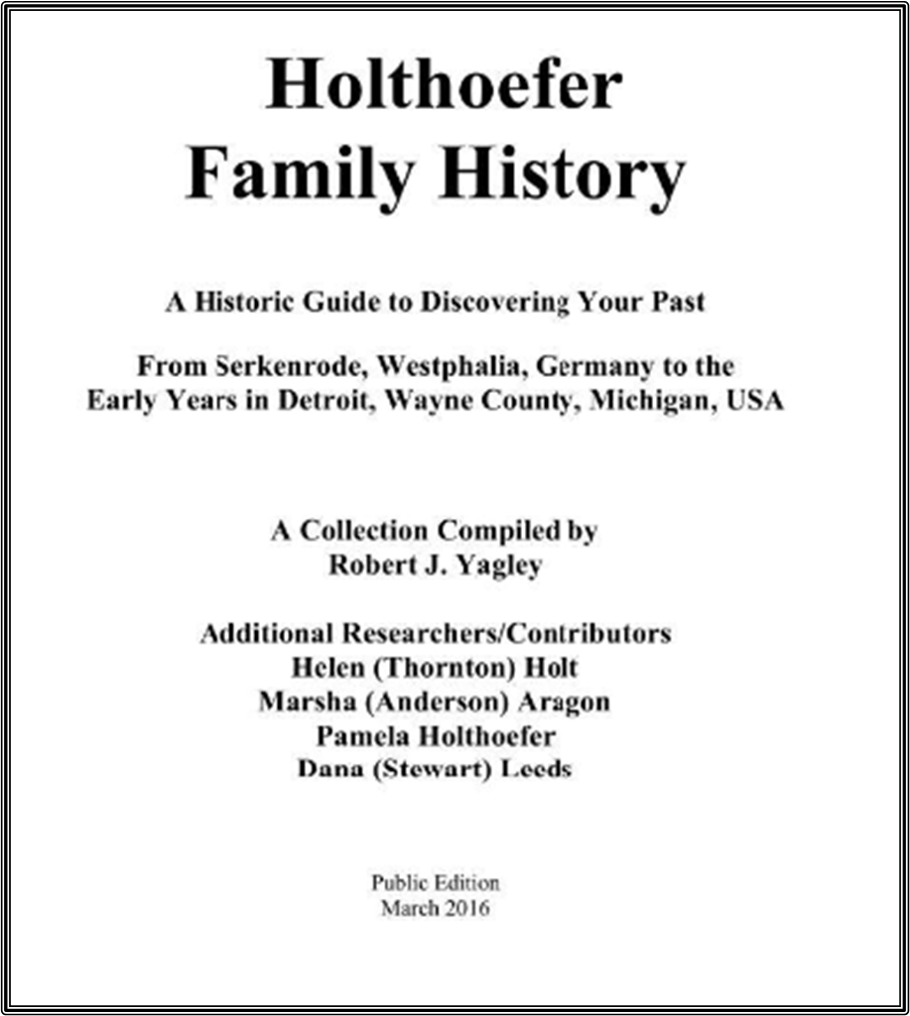
Accessing family histories listed in the FamilySearch Library catalog
Notes:
Accessing family histories listed in the FamilySearch Library catalog.

Slide 56
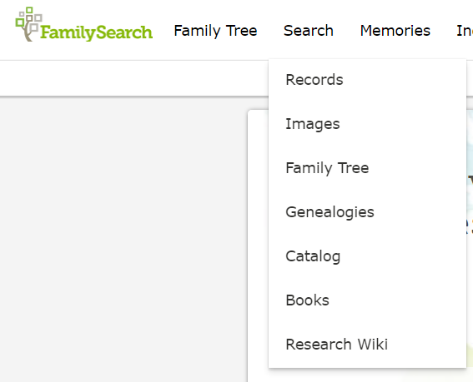
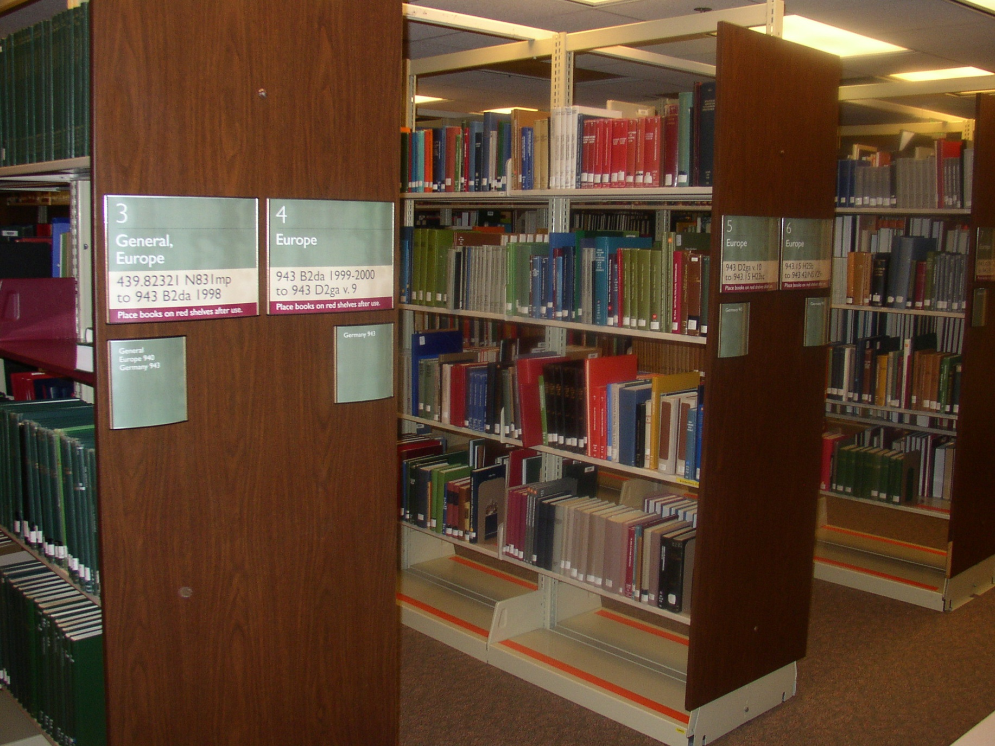
Family History Library
Notes:
After logging in to FamilySearch
Begin by clicking on the *“Search” tab.
Next click on *“Catalog”.

Slide 57
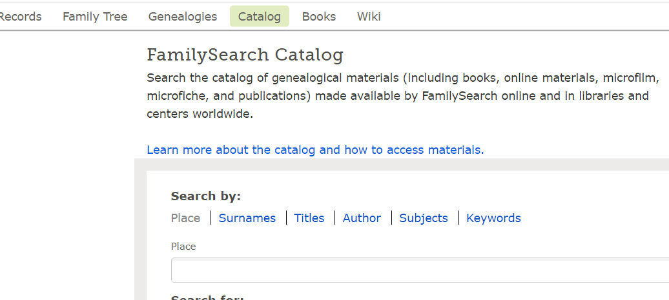
27
Notes:
Under the heading *“Search by” click on *“Surname”.

Slide 58
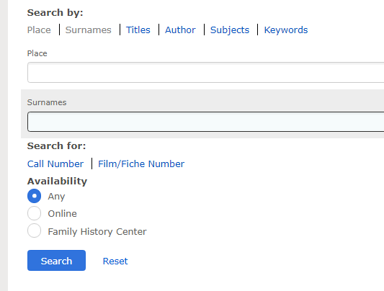
Burkhardt
28
Notes:
Type the family name in the Surname box. I am using the surname *Burkhardt as an example. Next click *“Search”.

Slide 59
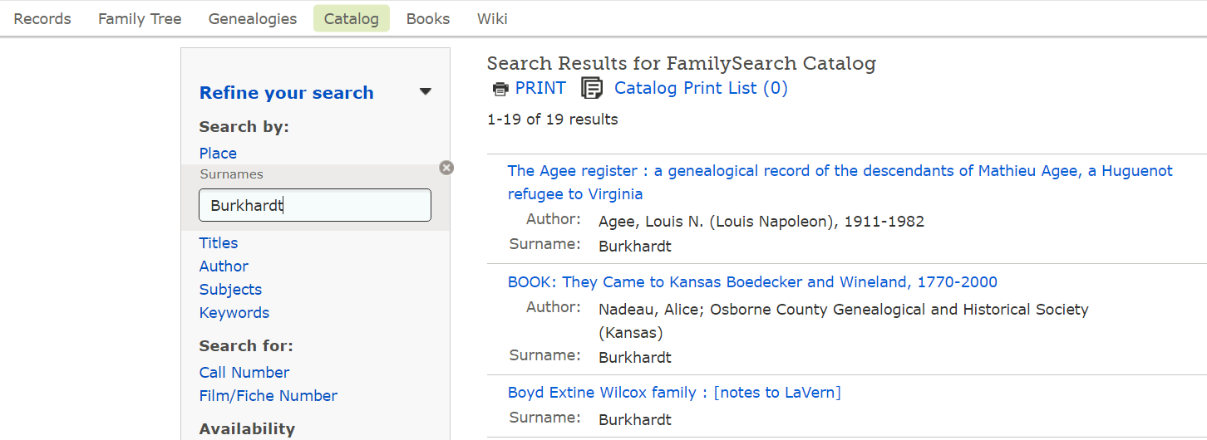
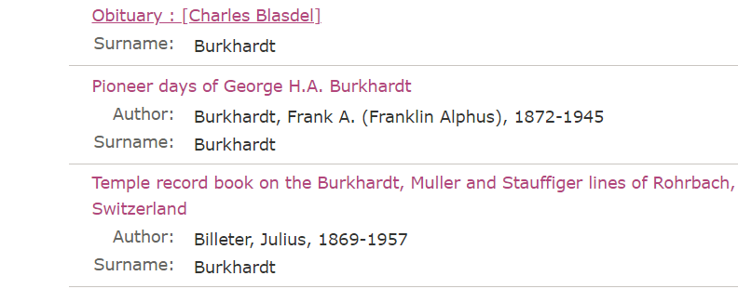
29
Notes:
Usually, a number of books and other resources will be listed. No matter how many are listed, it takes less than a minute to click on each one to determine if it is your family history or not.
To demonstrate, I will click on the book *titled Pioneer days of George H. A. Burkhardt.

Slide 60

30
Notes:
The first thing to look for are the *Notes on the middle and left side of the page.
In the second paragraph it begins with George Jacob Burkhardt’s name. It then gives his *birth and death years. The *year the family immigrated is given next. After that the *place in Germany where the family was from is given. Next it gives the *place in America where they settled. *The last thing is a list of family and relative names that are listed in the first paragraph. From this information you can quickly determine if it is your family or not.

Slide 61

Notes:
If you had a Burkhardt family and the information in the notes matched with your family information, then this would be your family history.

Slide 62

Deutsche Geschlechterbücher (German Lineage Books)
German Lineage Books
Notes:
Deutsche Geschlechterbücher (German Lineage Books)

Slide 63
Deutsche Geschlechterbücher or
German Lineage Books
Over 200 volumes from various areas of Germany
Compiled from parish, vital and other records
Written in German with a surname index in the back
Those published before 1933 are written in the old Gothic print.
Indexed on CD, includes volumes 1 – 107 at the Family History Library.
About 200 of the volumes are indexed in the 19-volume surname periodical index called the Familiengeschichtliche Quellen.
Notes:
There are currently 221 volumes individually indexed from various areas of Germany
They are compiled from parish, vital and other records
Written in German.
Those published before 1933 are written in the old Gothic print.
An Index on a CD, includes volumes 1 – 107 at the FamilySearch Library.
About 200 of the volumes are indexed in the 19-volume surname periodical index called the Familiengeschichtliche Quellen.
Volumes may contain pedigree charts, portraits & family crests.

Slide 64

Genealogical Handbook of Citizen Families
Notes:
On the title page, highlighted blue, it says that these genealogical handbooks pertain to citizen families. Not everyone was a citizen in Germany. Most of them were those in the middleclass.

Slide 65

Surname Index in the back of each volume
Notes:
On this index page at the back of the book,, the surname Schmeidler is the only name that is bolded. That is because it is a major family whose lineage is being traced in this volume. All the other names on this page would be collateral lines that are probably connected by marriage.

Slide 66

It begins with a pedigree outline. The numbers represent specific descendents.
Notes:
At the beginning of each family’s genealogy is a pedigree outline. The Roman numerals represent different generations, and the letters represent specific ancestors.

Slide 67
Symbols are used
as follows:
= birth,
= marriage
= death
Notes:
The Roman numeral number “I” on the pedigree outline will be the first generation on the compiled genealogy. This will be the earliest known ancestor.
The following symbols are used in each volume for birth, marriage and death.

Slide 68

These are not coats of arms but are occupational seals.
Notes:
What looks like a family crest may not be one. These two are occupational seals. The one on the left is for a pastor and the one one the left is for a shoemaker.

Slide 69

Family Crests
&
Coat of Arms
Notes:
If a family has a family crest it will be shown in the lineage book. If your direct line ties into nobility, you may have a family crest or coat of arms. Some coats of arms were awarded to officers in the military or for other meritorious service. These may have been awarded to just the individual or it may have been awarded to their family. Do not assume if there is a coat of arms with your surname that it is yours. Oficially Using a coat of arms that is not yours is illegal. But if you actually tie into a nobility line and want to know if there is a coat of arms, the last part of this webinar would explain how to find a coat of arms if a family had one.

Slide 70

Family Potraits
Notes:
Portraits are often included in these compiled genealogies.
You need to be aware that that if there is a portrait of your ancestor, professional portrait painters, who traveled from town to town, would pre-paint everything for a portrait except the face. They would then add the face of the person buying the portrait.

Slide 71

Gauch Family
Notes:
This is the FamilySearch pedigree chart, beginning with the great grandfather of a patron who came to the FamilySearch Library wanting to extend his Gauch family line back before 1780. Unfortunately, the library records, including church, civil registry, county, district, court and military only went back to 1782. I asked if he had checked any of the compiled genealogies and he said no.

Slide 72

German Lineage Books
Notes:
In using the German lineage books, the patron found his great grandfather Karl Gauch’s family listed in one of the volumes. It gave his pedigree identifier as *“XIIj.”

Slide 73

Gauch Family Line
Notes:
I showed him how to use his family’s overview pedigree chart that has no names, just roman numerals, and letters.

Slide 74
Notes:
The Roman numeral *XII indicates the generation from the earliest known ancestor. This means that Karl was in the twelfth generation, and the letter *j makes him one of the 9th great grandchildren of number I on the pedigree chart.
This general pedigree shows Karl’s parents Father *XIf and mother *XIc were first cousins.
And it shows that their fathers were *brothers.
So, in using the German Lineage books the patron was able to extend his Gauch line back another nine generations.

Slide 75

Deutsches
Familienarchiv
or
German Family Archive
Notes:
Deutsches Familienarchiv (German Family Archive)
An example of the use of this collection was given in the first Webinar.

Slide 76
Deutsches Familienarchiv
(German Family Archive)
Written in German in Roman print
Over 150 volumes currently available
Has a three-volume surname index for volumes 1 - 100 (not complete).
Currently has a surname index on CD (available for use at the Salt Lake Family Search Library).
Notes:
*It is written in German in Roman print
*Over 150 volumes are currently available.
*It has a three-volume surname index for volumes 1 - 100 that isnot complete.
*Currently it has a surname index on CD (available for use at the Salt Lake FamilySearch Library).

Slide 77
Johann Jakob Gmelin and his wife Philippine maiden name Frey, emigrated from Germany and settled in the state of Illinois.
Their place of birth in Germany was not known.
Notes:
Johann Jakob Gmelin and his wife Philippine maiden name Frey, emigrated from Germany and settled in the state of Illinois.
Their place of birth in Germany was not known.

Slide 78


Deutsches Familienarchiv index
Both names appear in volume 58 & 62
Notes:
A search was made to see if either the Gemelin or the Frey both surnames appear in the Deutsches Familienarchiv.
*The following shows that they both are in volumes 58 and 62.

Slide 79


Deutsches Familienarchiv volume 58
Notes:
The surname index in volume 58 shows that both names appear, but on different pages. Gmelin is on page 255 and Frey is on page 94.

Slide 80

On page 94, however, both are listed with important family information including the place of birth.
Notes:
On the bottom of page 94, it actually lists *Johann Jakob Gmelin born in Schwegenheim September 6, 1804. He was a Schreiner meaning joiner or cabinet maker and immigrated in1844. He died in Fayetteville, (Illinois) in 1867. He was married in Germersheim on 14 December 1830. His wife Philippine Elisabeth Frey died in Fayetteville in 1858. It lists their three children, Andreas, Elisabeth and Katharine.

Slide 81
Zentralstelle für Personen und
Familiengeschichte
Leipzig Germany
(Center for Personal and Family Research)
Notes:
Zentralstelle für Personen und Familiengeschichte,
or Center for Persons and Family Research
This center was established in 1904 in Leipzig Germany.
It has a large collection of funeral sermons and population records. But the pedigree index was the largest collection.

Slide 82
Die Ahnenstammkartei des Deutschen Volkes
or
Ancestral pedigree index of the German People
Zentralstelle für Personen und Familiengeschichte
(Center for Personal and Family history), in Leipzig, Germany
Notes:
Die Ahnenstammkartei des Deutschen Volkes
Translated it means Ancestral pedigree index of the German People.

Slide 83

Die Ahnenstammkartei des
Deutschen Volkes
(Ancestral pedigree index of the German People)
Notes:
The *FamilySearch Library catalog shows that there are two parts on microfilm. *Part 1 has 638 rolls of microfilm and *part 2 has 576 rolls for a total of 1,214 rolls.

Slide 84
Ancestral Pedigree Index of the German People
Historical Background
1904 - Zentralstelle für Personen- und Familiengeschichte was established.
1921 – The Ahnenlistenaustausch (ALA) [Ancestral List Exchange] was created.
1923 – Indexing of the Ancestral Lists began using phonetics.
1967 – It was housed at the Zentralstelle für Genealogie in Leipzig.
1991 – FamilySearch Library Microfilmed, 2.4 million cards comprised 5 – 6 million names, mostly for the time period of 1650-1750.
Notes:
Historical Background
*1904 - Zentralstelle für Personen- und Familiengeschichte or the Center for Persons and Family History was established.
*1921 – The Ahnenlistenaustausch (ALA), meaning Ancestral List Exchange, was created so people could share their ancestral information.
*1923 – Indexing of the Ancestral Lists began using phonetics.
*1967 – It was housed at the Zentralstelle für Genealogie in Leipzig.
*1991 – FamilySearch Library Microfilmed, 2.4 million cards comprised between 5 – 6 million names, mostly for the time period of 1650-1750.

Slide 85

Die Ahnenstammkartei des Deutschen volkes by
Thomas K. Edlund
Notes:
A book about the Ahnenstammkartei des Deutschen Volkes and how to use it was published by Thomas K. Edlund titled Die Ahnenstamkartei des Deuthschen Volkes an Introduction and Register
Published 1995.

Slide 86

Die Ahnenstammkartei des Deutschen volkes
Notes:
A detailed article was written on how to use and search this collection. It was written and published in the German Genealogical Digest, in 1993, vol. 9 issue 4 page 110. Also, you can search for copies of these two resources on Worldcat.org.

Slide 87

German Genealogical Digest
Volume No. 9
Winter
1993
Issue No. 4
Notes:
The main author of this article was Laraine Ferguson, whose family had submitted their genealogy to the Center for Genealogy in Leipzig Germany. Her ancestral family was therefore included in the Ahnenstammkartei.

Slide 88

Notes:
The following symbols are used, and surnames are written phonetically in the Ahnenstammkartei as shown here.

Slide 89

Every locality name was verified using the Meyers gazetteer
Notes:
Frequently locality names will also be written phonetically but not in the Ahnenstammkartei. As this shows, the spelling of every locality was verified using the Meyer gazetteer.

Slide 90


Die Ahnenstammkartei des
Deutschen Volkes
Notes:
These are examples of the information found on the index cards that were created.

Slide 91

Notes:
This is an example of an Ahnenliste (list of ancestors). All of the information that was found on the pedigree that was submitted was extracted and entered on the Ahnenliste This list was arranged alphabetically by surname and then by generation. All of the data pertaining to each induvial was then added following their name.

Slide 92


Locality, Subject, and Submitter Indexes
Notes:
Also included are special Locality, Subject and Submitter indexes.

Slide 93
Locality and Family Lineage Books
Notes:
Locality & Family Lineage Books
There are 3 Types of Locality & Family Lineage Books.
Locality and Family Lineage Books
In 1933, a government official proposed extracting names and data from all the parishes in Germany and compiling a single name index for each parish.

Slide 94
Dorfsippenbücher
1937 Arbeitsgemeinschaft für Sippenpflege
52,000 Parishes
350,000 Parish registers
And about 700,000,000 Parish entries
People involved – 14,000
Goal – complete 30,000 by 1970
1938 - 30 volumes were completed
Notes:
These are called the Dorfsippenbücher or Village
Lineage Books
Before doing this, in 1937 the Arbeitsgemeinschaft für Sippenflege or Worker Society for Lineage Research, determined that there were about,
*52,000 Parishes in Germany
*350,000 parish registers and
About *700,000,000 Parish entries
*They employed 14,000 People
*Goal was to complete 30,000 village lineage books by 1970
*By 1938, they had completed 30 volumes.

Slide 95

1937–1938, 30 (1%) Village Lineage Books
Notes:
The following are the nobility and provincial areas and the number of village lineage books that were created for each. These 30 represented one percent of the village lineage books they intended to complete.

Slide 96
WORLD WAR II
Notes:
With the outbreak of World War II, the project stopped and after the war it was never continued.

Slide 97


Ortssippenbücher
Dorfsippenbücher / Ortssippenbücher
Notes:
When individuals, groups, and genealogical societies saw the value of the lineage books that had been published, they began creating what they called Ortssippenbücher (locality lineage books) These were patterned in their format after the Dorfsippenbücher.
Both the village and the locality lineage books are listed in the *FamilySearch Library catalog under the locality name. Here we have the town of *Ebermergen, Bavaria. And then under the subject heading *“Genealogy”. This is the *title page for the Ortssippenbuch of Ebermergen, Bavaria.

Slide 98
Contents of Locality & Village Lineage Books
Surname & Locality Indexes
History and Culture of the Locality
Map of town and surrounding area
Statistical Information
Notes:
The contents of locality and village lineage books include.
*Surname & locality indexes
*History and culture of the locality
*Map of town and surrounding area and
*Statistical information.

Slide 99


Volume No. 7
1991
Issue No. 2
Page 43
Notes:
An article about the German village and locality lineage books was published in the German Genealogical Digest 1991, volume 7, Issue No. 2, page 43.

Slide 100

Borchard Family
Dorf and Ortssippenbuch Formats
Notes:
The formats of the Dorf and Ortssippenbücher are the same. They are arranged alphabetically by surname. The Borchard family is used in this example. A consecutive number was assigned to each family. The Borchard family number *88 appears in the upper left corner of the entry.

Slide 101
Borchard Family
Marriage Date
4 October 1839
Notes:
A family is established at the time of the wedding. The wedding date of this couple is *4 October 1839. It is given after the family number 88.

Slide 102
Borchard Family
Husband’s Name:
Christian Friedrich Borchard
Notes:
The husband’s name, Christian Friedrich Borchard, is given after the marriage date.

Slide 103
Borchard Family
Occupation:
Cottager & Master Tailor
(*) His birth date 16 Jul 1812
(†) His death date 14 June 1870
Notes:
The husband’s occupation is given next, if it is known. This shows that he was a cottager and master tailor. This is followed by his date of birth on *16 July 1812 and his death on 14 June 1870.

Slide 104
Borchard Family
His
Parent’s
No. 83
Notes:
The number following the husband’s name is 83 which is the number for his parents. By going to that number, you would find his parents with Christian and his siblings listed.

Slide 105
Borchard Family
Wife’s Name
Marie Luise Charlotta Borchard
(*) Birth Date: 30 May 1815
(†) Death Date: 24 September 1846
Notes:
Following the husband’s information, the wife’s name is given as *Marie Luise Charlotte Borchard, along with her date of birth on *30 May 1815 and death on 24 September 1846.

Slide 106
Borchard Family
Her parent’s No. 86
Notes:
Following her maiden name, her parents’ family number, 86, is given. Again, by going to that number you will find her parent’s with her and her siblings.

Slide 107

Christian Friedrich’s father & Marie Luise Charlotte’s father were brothers. They came from the same parent’s No. (81)
Notes:
If we looked up the family number for both parents, we would see that both of their fathers had the same family number *81, meaning that they had the same parents. *In other words, the husband’s father and the wife’s father were brothers, making Christian Friedrich and Marie Luise Charlotte first cousins.

Slide 108

Notes:
The next resource for lineage books is the German website called GenWiki. To access it search online for “GenWiki de”. This Main Page of the website will come up and a *dropdown box will appear giving you the option to have it translated into English.

Slide 109



Notes:
At the top of the main page is a *list of resources. Included on this list is the resource called *“OFBs”.
Which stands for Ortsfamilienbücher or Locality Family Books.

Slide 110

Notes:
By clicking on “OFBs”, it takes you to the page that the Ortsfamilienbücher are on. The books are listed alphabetically by their locality name, under the *modern German state to which they belong. In this example I will *click on the town of Esslingen

Slide 111


Notes:
This brings up historical and other information concerning the town of Esslingen.
Next, click on the *“Complete List of Surnames” under “Functions” in the column on the left.

Slide 112

Notes:
This brings up the alphabet so you can click on your surname. Here I am clicking on the surname *Autenrieth.

Slide 113

Notes:
After clicking on the surname Autenrieth, a list of those with the surname comes up, arranged alphabetically by given names with their birth information.

Slide 114
Mappenstücke
Notes:
I will talk about the Mappenstücke next. It is described as a “monstrous” collection of family-history documents including pedigrees, newspaper clippings, articles, family histories etc.
Mappe means portfolio, case, or envelope.
Stücke means pieces.
So, in this case, Mappenstücke means an envelope or something that is filled with various pieces of genealogical data or information.

Slide 115
Mappenstücke
This collection is on 236 rolls of microfilm
30,000 Family Envelopes
Notes:
This collection of genealogical material pertains mostly to the German people living in what was formerly the German Democratic Republic or East Germany.
It is contained on 236 rolls of microfilm that are digitized making it easy to search by surname or locality name. And it is made up of genealogical material found in about 30,000 family envelopes.

Slide 116




Accessing the Mappenstücke
On the
FamilySearch Library Catalog
Notes:
Accessing the Mappenstücke in the FamilySearch Library catalog.
After logging in to FamilySearch, click on *“Search”.
Next click on *“Catalog”.
Under *“Search by:, click on *“Keywords”
Type in *“Mappenstucke” and click “search”.

Slide 117


“Search by”
Ctrl-F
Schunck
Notes:
A random list of Surnames is listed representing the envelopes containing the genealogical documents for each family. Since there is no alphabetical order to the surnames you must do a search by holding the Control key down and typing the letter F, for “find”, then type your surname. In this example I have entered the surname “Schunck”.

Slide 118

Mappenstücke
Notes:
It immediately takes me to *the Schunck name and states that the family was from Eisenberg in Pfalz, Bavaria. On the right it gives *film number 1945505 that the Schunck family documents are found on.

Slide 119

Notes:
There is one document. It is a printed pedigree for the Schunk family.

Slide 120

Notes:
It is a descending pedigree with the earliest ancestor listed before 1572.

Slide 121

Notes:
With descendants listed down to the 1820’s.

Slide 122
Leichenpredigten
(funeral sermons or Obituaries)
Notes:
Leichenpredigten
We’ll now talk about Leichenpredigten that are funeral sermons or obituaries.

Slide 123

Article on German Funeral Sermons
Notes:
A detailed article about German funeral sermons was written in the German Genealogical Digest in 1992 4th quarter volume 8 number 4, that explains what they were, what information they contained, and how to use them in genealogical research.

Slide 124
German Funeral Sermons
Historical Background
  Began in the mid 1500s during the Reformation
  Reached the height of popularity in the 1600s
  Written in the Baroque style of the times, 8 – 10 pages in length
Notes:
Funeral sermons originated with the Lutheran Church in the mid-1500s.
It began with the middle- and upper-class population but by the 1600s it was common among most classes.

Slide 125
FUNERAL SERMON
FORMS
ORTHODOX (Lutheran)
(began mid 1500)
Sermon separate from life history & praise
&
CLASSICAL (Catholic)
(began about 1700
Praise included with sermon
Notes:
There were two forms of funeral sermons. The first was the orthodox form, established by the Lutheran Church. In the orthodox the sermon was separate from the history and praise. The second was the Classical form, established by the Catholic Church which combined the praise with the sermon.

Slide 126
Funeral Sermon Elements
  TITELBLATT (Title Page)
  DEDIKATION (Dedication)
  LEICHENPREDIGT (Devotional Sermon)
  EPIZEDIEN / GEDICHTE / SPRÜCHE (Poems and maxims)
  PERSONALIA (Personal history)
  PORTRÄT (Portrait)
Notes:
The following are the six different elements that made up the funeral sermon:
Titelblatt (title page)
Dedikation (dedication)
Leichenpredigt (devotional sermon)
Epizedien/Gedichte/Sprüche (Poems and axims)
Personalia (personal history)
Porträt (portrait)

Slide 127
TITELBLATT (Title Page)
Includes
Name of deceased (or spouse’s name if it is a woman)
Compiler
Printer
Place and year of printing
Notes:
The title page provides some information but not much. You have the name of the deceasedand the name of the person who compiled it. This is usually a family member, which can be helpful.

Slide 128
DEDIKATION (Dedication)
  Contains Names of living relatives or descendants
  (found on back of title page or on the first page of text)
Notes:
The Dedication can be especially valuable because of the family members that could be listed.

Slide 129
LEICHENPREDIGTEN
(Devotional or sermon)
    Except for the Catholic Classical funeral sermons
    Sermons did not usually include information on the deceased.
Should be searched nevertheless
Notes:
Catholic Classical funeral sermons include praise and family information in the sermon and should always be searched. The Lutheran Orthodox funeral sermons usually do not include praise and family information, but they should be searched just to make sure.

Slide 130
EPIZEDIEN/GEDICHTE/SPRÜCHE (poems and maxims)
Latin and German poems and sayings
(little value unless the author was a relative)
Notes:
Latin and German poems and saying do not provide family information unless it was written by a family member.

Slide 131
PERSONALIA (personal history)
Most informative part of funeral sermon.
may contain:
christenings, confirmations, marriages,
&
late ancestor’s way of life and virtue
(completeness of information determined by submitter)
Notes:
The personal history provides the most information about the family’s lineage and relationships including christenings, confirmation, and marriages. The accuracy of it depends on who the submitter was.

Slide 132
German Leichenpredigten (funeral sermons)
1500’s – 1800’s
Contents:
Name of deceased
Date and place of birth
Father = Father’s Father & Mother + Grandparents
+ Mother’s Father & Mother + Grandparents
Mother + Father’s Father & Mother + Grandparents
+ Mother’s Father & Mother + Grandparents
Notes:
The following is an outline of the family relationships that are found in the funeral sermon document.

Slide 133

Example of Funeral Sermon
Notes:
These are the contents from an actual funeral sermon document of a 17-month-old child.

Slide 134

PORTRÄT (Portrait)
Portrait of the deceased was often included in the printed funeral sermon.
Notes:
As was already mentioned, portraits are also added.

Slide 135

Accessing Funeral Sermons at the Family History Library
Notes:
Accessing Funeral Sermons found at the FamilySearch Library in Salt Lake City, Utah.

Slide 136


Notes:
The FamilySearch Library has acquired a number of indexes to Funeral Sermons as well as collections of funeral sermons.

Slide 137

Searching the Library catalog for Funeral Sermons
Notes:
Searching the Library catalog for Funeral Sermons

Slide 138


Searching for Funeral Sermons
search first under the name of the nobility or province, i.e.,
Germany, Bayern
Or under the city
Germany, Bayern, Augsburg
Search next under the subject heading of Obituaries
Notes:
You can search for funeral sermons in the library catalog either under the nobility or provincial name such as
*Germany, Bayern or
under the *city name as Germany, Bayern, Augsburg
Then under subject heading of *Obituaries.

Slide 139
Accessing Funeral Sermons in German Periodicals
Notes:
Accessing Funeral Sermons in German Periodicals
Many of the compiled funeral sermons and their indexes have been published in various German periodicals.

Slide 140



Die Leichenpredigten in der Gräflich von Schlitz-Görtz-Wrisbergschen
Archiv für Sippenforschung und alle verwandten Gebiete
Notes:
As has been mentioned earlier, over 600 German periodicals have been identified. Some focus on specific nobility and provincial areas and some cover the former German empire. As can be seen on the map, the periodical called Archiv für Sippenforschung (Archive for lineage research) has articles that do cover the whole empire. The one circled in red on the map, pertains to the article on the right which contains extracted funeral sermons from the Prussian province of Hannover.

Slide 141
Augsburg
Korb’sches Sippenarchiv, “Index to Augsburg City Archive 17th-18th Century Funeral Sermons.” Regensburg: Korb’sches Sippenarchiv, 1963. (FSL 943 – B4df No. 28, microfilm 0924416 item 2
Erlangen
Staehlin, Agnes. “Index of Erlangen University Archive Funeral Sermons, Poetry and Eulogies 1518-1945” Erlangen: Universitaetsbibliothek, 1978. (FSL 943.3/E4 – V4s
Rothenburg ob der Tauber
Lenz, Rudolf. “Indexed Catalog of Funeral Sermons.” Marburg/Lahn: Schwarz-Verlag, c1983. Indexed, (FSL 943.3/R7
Funeral Sermons Published in Books
Notes:
We have already mentioned Funeral Sermons in periodicals. There have also been books published about them, such as the following:

Slide 142

Funeral Sermons in German Repositories
Notes:
Funeral Sermons in German Repositories
Many of the collections of funeral sermons have ended up in repositories such as the following Berlin, Braunschweig, Lübeck, Pommern and Westfalen.

Slide 143

Minerva, Achive im deutschsprachigen
Raum
Locating archives with Funeral
Sermons
Notes:
Locating archives with Funeral Sermons
The two volume work called
Minerva Handbücher Archive im deutschsprachigen Raum
or Minerva Handbooks Arichves in German speaking areas. Is one of the best resources for identifying archives and their holdings. It even includes areas of Germany that were lost to other countries after World Wars I and II.
A detailed description and its use were given in Webinar No. 2 of this series.

Slide 144


Notes:
In volume one of this set of books is the section on the Minden city archive. Under the heading “Bestände”, meaning holdings, it shows that there are 2,700 documents pertaining to Funeral sermons.

Slide 145
How do you determine if your ancestor had a funeral sermon?
Search the church death and burial records
Notes:
Determining if your ancestor had a funeral sermon.
If the ancestral town or area had burial records or obituaries, they need to be searched.

Slide 146

“mit einer Leichenpredigt von der Kanzel”
With a funeral sermon from the pulpit
Notes:
The next thing to do is to search for the death record to see if it indicates that there was a funeral sermon. In the following death record for a Hinrich Twiefel, the minister wrote:
“mit einer Leichenpredigt von der Kanzel”
(With a funeral sermon from the pulpit.) Sometimes Leichenpredigt is abbreviated as “Lpr.” or “L. Pr.”

Slide 147
Errors in Funeral Sermons
Notes:
Errors in funeral sermons
Were all funeral sermons accurate and without errors? No.
It is important not to assume all the information in a funeral sermon is correct. Leichenpredigten were also referred to as “Lügenpredigten” (a lie or false sermon). People were not that concerned whether the information was accurate or not.
Information concerning the deceased’s ancestors was added at the end of the life’s story. And the more distant the relationship the greater the probability of error in names, dates, and places.

Slide 148
Funeral Sermon of:
Rosine Maria Sophia Donner, maiden name Husswedel
FATHER: Johann (Joachim Bernhard Husswedel
OLDER SISTER: married in 1759 (married 15 October 1754)
HUSBAND: married Johann Wilhelm Donner 16 September 1764 (married 15 October 1764)
SON: 18 years old (age 21 years old)
DAUGHTER: 7 years old (age 3 years old)
Mistakes in Names and Dates
Notes:
The following are mistakes in names and dates with the correct names and dates written in parenthesis.
Funeral Sermon of:
Rosine Maria Sophia Donner, maiden name Husswedel
Her FATHER: was listed as Johann (Joachim Bernhard Husswedel
Her OLDER SISTER: was recorded as being married in 1759 (married 15 October 1754)
Her HUSBAND:It showed she married Johann Wilhelm Donner 16 September 1764 (married 15 October 1764)
Her SON: was listed as being 18 years old (age 21 years old)
DAUGHTER: 7 years old (age 3 years old)

Slide 149
Wrong Ancestor
Notes:
The case of the wrong ancestor

Slide 150
Andreas Covinus
Funeral Sermon – Family History
Born: 1575
Place: Neuhaldensleben
Descendant of the theologian Anton Corvinus, assistant of Martin Luther.
  Anton Corvinus had five children. Only a daughter survived to have children.
  Never assume anything and verify everything!
Notes:
Funeral sermon of Andreas Covinus, born 1575 in Neuhaldensleben
*In the funeral sermon, it was claimed that Andreas Covinus was the descendant of theologian Anton Corvinus who was the assistant of Martin Luther.
*Anton Corvinus had five children. Only one daughter survived to have children. So Andreas Covinus could not have been his descendent. *Never assume anything and verify everything!

Slide 151
Finding a Coat of Arms
Steps and resources to use to find a coat of arms.
Notes:
Steps and resources to use to find a coat of arms. All of the books used in determining a coat of arms can be found at the FamilySearch Library in Salt Lake City.

Slide 152


Brummer
Family
of
Württemberg
General Index to Siebmacher Coats of Arms Books
1605 - 1967
943
D6j
index
Notes:
This is the first book to use. *The title page gives the name as General-Index zu den Siebmacher’schen Wappenbüchern 1605-1967, *Translated means General Index to Siebmacher Coats of Arms Books 1605 - 1967. The book’s *call number is 943 D6j.

Slide 153

Notes:
In this book, the surnames are listed alphabetically. In this example, under the name *Brummer, is the *locality abbreviation WüA. The “Wü” is for Württemberg and the “A” is for Abgestorben, which means deceased. The number *187 is a page number. In the volume pertaining to Württemberg that the name Brummer is found on.

Slide 154


Notes:
In the front of this index book is a list of the locality abbreviations. Looking up *the WüA, it shows that it is in *volume 23. To the right, it verifies that it pertains to *Württemberg Abgestorbene. To the right of that is microfilm number *1636808, item 3.

Slide 155


Die Wappen
Des Adels
In Württemberg
943
D6j
v. 23
Notes:
In another set of heraldry books, is the book that contains the coats of arms for the *kingdom of Württemberg. The *title page shows that it is volume 23, as referred to in Siebmacher’s coat of arms index book.

Slide 156

Notes:
In the index to coat of arms, it stated that the Brummer name was on page *187. Turning to that page in volume 23, It shows the entry for the Brummer family.

Slide 157
Notes:
This entry provides the family information of Benedict Brummer from Bärenfeld. On the top right of the entry is a reference to * “Taf. 100” or table 100.

Slide 158

Notes:
Turning to *table 100, in the middle on the left side is the *coat of arms for the Brummer family.

Slide 159


  End of Part IV
  This concludes this 4-part Webinar
  Series!
  Questions?
  Email:
  jensenlo@burgoyne.com
  End of Webinar 7
  of this 9-part German Genealogical Research Series!
  Questions?
  For copies of this PowerPoint
  Email me at:
  jensenlo@burgoyne.com
German Genealogical Research
-------- With Larry Jensen ---------
Notes:
This concludes Webinar number seven in our series.

